Slide 1
Care of Patients with Pituitary and Adrenal Gland Problems

Slide 2
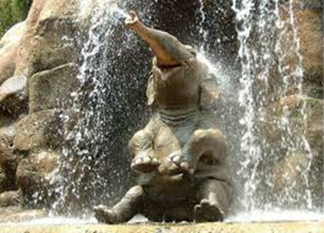
Name the Disorder:
Acromegaly
“I have gone up two shoe sizes over the last several years.”

Slide 3
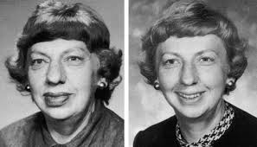
Disorders of the Anterior Pituitary Gland: Hyperpituitarism
Overproduction of the growth hormone = Acromegaly
Most often occurs as a result of a benign pituitary tumor (adenoma)
Overgrowth of soft tissues and bones in the hands, feet, and face
Gigantism
Enlargement of hands, feet, face, and head
Voice deepens and enlargement of tongue
(Making speech difficult, sleep apnea)
Skin becomes thick, leathery, and oily
Hyperglycemia
(GH antagonizes action of insulin)
Cardiovascular effects

Slide 4
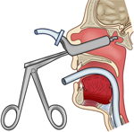
Treatment of Acromegaly: Hypophysectomy
Goal is to return the patient’s GH levels to normal.
Bone growth can be stopped and tissue hypertrophy reversed
Sleep apnea, diabetic, and cardiac conditions may persist
Radiation Therapy
Drugs (Octerotide)
Surgery (treatment of choice because best chance for cure)
When entire pituitary is removed – permanent loss of all pituitary hormones
Need ADH, cortisol, and thyroid replacement
Loss of FSH and LH can lead to decreased fertility
Endoscopic transsphenoidal approach
Combination of above

Slide 5
Nursing Care after Hypophysectomy
↑HOB 30 degrees to ↓headaches
Assess neuro
Avoid coughing, sneezing, or straining with stool
(To prevent CSF leakage)
Send clear nasal drainage to lab, glucose­ ­­­­>30 = CSF leakage
No tooth brushing for 10 days
Hormone replacement

Slide 6
Disorders of the Anterior Pituitary Gland: Hyperpituitarism
Excess of other Tropic Hormones
↑ ACTH (Adrenocorticotropic Hormone) = Cushing’s
↑ TSH (Thyroid Stimulating Hormone) = Hyperthyroidism
↑ FSH (Follicle Stimulating Hormone) & LH (Lutenizing Hormone)
↑ Prolactin = galactorrhea, anovulation, infertility, decreased libido, amenorrhea, and hirsutism in women; impotence, decreased sperm density, decreased
↑ GH (Growth Hormone) = acromegaly

Slide 7
Disorders of the Anterior Pituitary Gland: Hypopituitarism
Decrease in one or more of the pituitary hormones
Total failure of the pituitary gland = panhypopituitarism
Most common hormone deficiencies involve GH and gonadotropins (LH & FSH)

Slide 8
Disorders of the Anterior Pituitary Gland: Hypopituitarism
↓ GH = truncal obesity, decreased muscle mass and strength, weakness, fatigue, depression, flat affect
↓ FSH & ↓LSH = menstrual irregularities, loss of libido, decreased breast size, testicular atrophy, ↓ sperm, decreased facial hair and muscle mass
↓ TSH = Primary hypothyroidism
↓ACTH = Deficiency of cortisol – weakness, fatigue, HA, dry & pale skin, diminished axillary and pubic hair, lowered resistance to infection, hypoglycemia

Slide 9
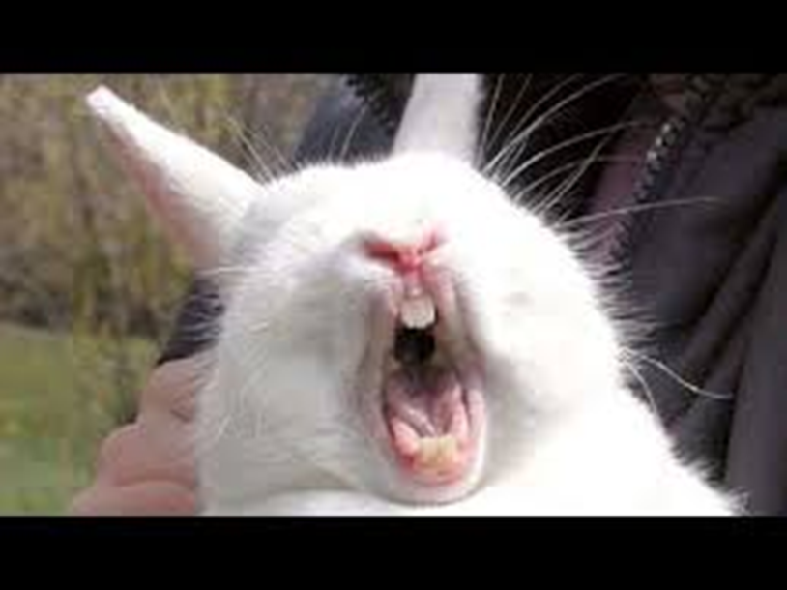
Name the Disorder:
SIADH
“I still get muscle cramping in my legs. I was put on a fluid restriction for my condition and it is really hard.”

Slide 10
Disorders of the Posterior Pituitary Gland: Syndrome of Inappropriate Antidiuretic Hormone (SIADH)
Overproduction ADH
Fluid retention
Serum hypoosmolarity
Dilutional hyponatremia, hypochloremia
Concentrated urine (In presence of normal intravascular volume and normal renal function)
More common in older adults
Tumors = most common cause

Slide 11
SIADH
Copyright © 2011, 2007 by Mosby, Inc., an affiliate of Elsevier Inc.

Slide 12
Disorders of the Posterior Pituitary Gland: Syndrome of Inappropriate Antidiuretic Hormone (SIADH)
Clinical Manifestations:
Muscle cramping and weaknes
↓ urine output and high specific gravity (>1.025)
Low serum osmolality
Weight gain without visible edema (Generalized edema)
Vomiting
Seizures

Slide 13
Disorders of the Posterior Pituitary Gland: Syndrome of Inappropriate Antidiuretic Hormone (SIADH)
Collaborative Management:
Na>125=restrict fluids 800-1000 ml/day
Na<125= 3%-5% NS-hypertonic-pulls fluids from ECF and fluid restriction 500ml/day
May use Lasix to diurese, but only if Na >125
Declomycin blocks the affect of ADH and ↑ urine output
Supplement diet with Na and Potassium

Slide 14
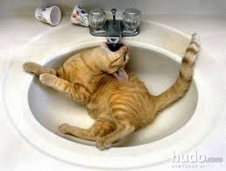
Name the Disorder:
Diabetes Insipidus
“I am constantly thirsty. I drink water all day long. Then I have to get up and go to the bathroom all the time.”

Slide 15
Disorders of the Posterior Pituitary Gland: Diabetes Insipidus
Deficiency of production or secretion of ADH or decreased renal response to ADH
Central (neurogenic) DI = interference with ADH synthesis.
Ex: brain tumor, head injury, brain surgery, CNS infection
2. Nephrogenic DI = Inadequate renal response to ADH despite adequate amounts of ADH
Ex. Drug therapy (lithium), renal damage, hereditary
3. Primary DI = Excessive water intake
Ex. Structural lesion in the thirst center, psychologic disorder
↑ urine output

Slide 16
Diabetes Insipidus

Slide 17
Disorders of the Posterior Pituitary Gland: Diabetes Insipidus
*Must assess for after intracranial surgery/ pituitary surgery
Clinical Manifestations:
Polydipsia
Polyuria (2 to 20 L/day)
Low urine specific gravity (<1.005) and urine osmolality
High serum osmolality
Electrolyte imbalances - Hypernatremia

Slide 18
Disorders of the Posterior Pituitary Gland: Diabetes Insipidus
Collaborative Management:
Maintenance of adequate hydration and fluid and electrolyte balance
Monitor for acute dehydration
Acute DI fluid replacement = IV hypotonic saline or D5W
Central DI = hormone therapy
Nephrogenic DI = Low Na diet, thiazide diuretics (reduces flow to the ADH-sensitive distal nephrons), indomethacin (helps increase renal responsiveness to ADH)

Slide 19
Name the Disorder:
Cushing Syndrome
“I feel tired and weak all the time. I have put on a lot of weight in the last several months, especially in my face and abdomen. The worst is I’ve been growing hair on my face and I’m a women!”

Slide 20
Disorders of the Adrenal Cortex: Cushing’s Syndrome
Chronic exposure to excess of corticosteroids (primarily glucocorticoids)
Tumors – Adrenal, Pituitary (↑ ACTH), or ectopic ACTH producing tumors
Manifestations of Cushing’s can be seen in most body systems due to excess levels of corticosteroids.

Slide 21
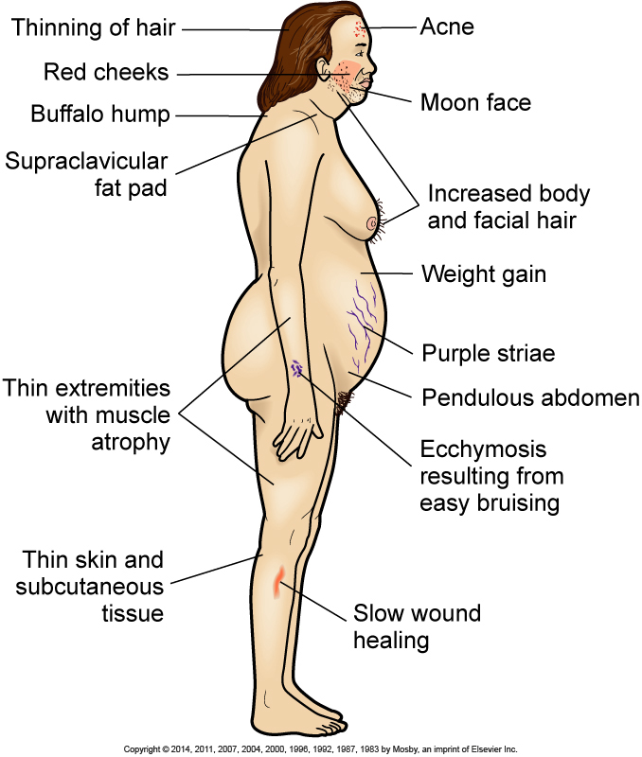
Cushing’s Syndrome: Clinical Manifestations

Slide 22
Cushing’s Syndrome: Clinical Manifestations
Weight gain-trunk, face, and cervical spine-truncal obesity
↑ glucose - glycosururia
Muscle wasting and weakness and fractures
Skin thinner and easily bruised, Acne
Mood disturbances
HTN
Moon face with reddened skin, red striae on abdomen, and hirsutism
Menstrual disorders
Hypokalemia, Hypernatermia
Na and Water retention – edema

Slide 23
Cushing’s Syndrome
Collaborative Management:
Goal = normalize hormone secretion
For tumors treatment = Surgery
Most of the physical changes will resolve after surgery
Medications-inhibit corticosteroid synthesis
Tapering of steroids
Gradual decrease of steroids to avoid adrenal insufficiency crisis.

Slide 24
Cushing’s Syndrome:
Nursing Considerations:
Monitor for fluid imbalance
High potassium, high protein, low carbohydrate, low sodium diet
Provide emotional support
Monitor for infection
Steroids administration
Obtain urine samples collected at the same time each morning to check level of cortisol

Slide 25
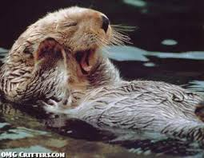
Name the Disorder:
Addison’s Disease
“I am tired most of the time. I’m not very hungry most of the time. I am nauseated a lot, but I do crave potato chips. I have lost weight a lot of weight. Also my hands are tan even though I don’t go out in the sun very much.”

Slide 26
Disorders of the Adrenal Cortex: Addison’s Disease
Most common cause autoimmune
Adrenal tissue is destroyed by own antibodies
Adrenocortical insufficiency
All corticosteroids (glucocorticoids, mineralocorticoids, and androgens)
Clinical manifestations often do not occur until 90% of adrenal cortex is destroyed – often advanced disease when diagnosed

Slide 27
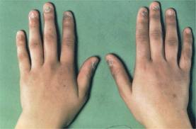
Addison’s Disease
Clinical Manifestations:
Progressive weakness
Weight loss, Anorexia
Fatigue
Hyperpigmentation in sun exposed areas, pressure points, joints, and hands – caused by increased ACTH
Nausea, vomiting, diarrhea
Orthostatic hypotension
Hyponatremia, Salt craving
Hyperkalemia

Slide 28
Addisonian Crisis
Life threatening
Caused by insufficient adrenocortical hormones or a sudden↓ in hormones
Triggered by stress, sudden withdrawal from steroids, adrenal surgery, or sudden pituitary gland destruction
Hypotension, Tachycardia
Hyponatremia, Hyperkalemia, Hypoglycemia
Fever, weakness, and confusion
Monitor VS, fluids, electrolytes, s/s infection
Hormone therapy/ steroids (High dose hydrocortisone replacement)
Decrease stimuli

Slide 29
Addison’s Disease
Teaching
Symptoms of under and over dosing of steroids
Lifelong steroid replacement
2∕3 of medication in am and 1∕3 in afternoon
Stress management and increased need for steroids with stress
Double steroids with minor stress
Triple steroids with major stress

Slide 30
Hyperaldosteronism
Caused by an adenoma
Hypertension
Sodium retention (↑Na)
Potassium (↓K) and hydrogen ion excretion (alkalosis)
Hallmark = hypokalemic alkalosis

Slide 31
Disorder of the Adrenal Medulla: Pheochromocytoma
Rare condition caused by tumor on the adrenal medulla
Increased production of Catecholamines (epinephrine, norephinephrine)
If left untereated = hypertensive encephalopathy, Diabetes Mellitus, cardiomyopathy, death
Attacks may be provoked by medications
Clinical Manifestations:
Severe hypertension, Severe headache, Tachycardia with palpations, Sweating, Unexplained abdominal pain and/or chest pain

Slide 32
The nurse is caring for a client with pheochromocytoma who is scheduled for adrenalectomy. In the preoperative period, what should the nurse monitor as the priority?
Vital Signs
Intake and Output
Blood urea nitrogen results
Urine for glucose and ketones

Slide 33
a. Vital Signs
Pheochromocytoma is a catecholamine-producing tumor. Hypertension is the hallmark of pheochromocytoma. Severe hypertension can precipitate a stroke or sudden blindness. Although all the options are accurate nursing interventions for the client with pheochromocytoma, the priority nurisng action is to monitor the vital signs, particularly the blood pressure.

Slide 34
The nursing instructor asks a student to describe the pathophysiology that occurs in Cushing’s disease. Which statement by the student indicates an accurate understanding of this disorder?
“Cushing’s disease results from an oversecretion of insulin.”
“Cushing’s disease results from an undersecretion of corticotropic hormones.”
“Cushing’s disease results from an undersecretion of mineralcorticoid hormones.”
“Cushing’s disease results from an increased pituitary secretion of adrenocorticotropic hormone.”

Slide 35
d. “Cushing’s disease results from an increased pituitary secretion of adrenocorticotropic hormone.”
Cushing’s disease is a metabolic disorder characterized by abnormally increased secretion (endogenous) of cortisol, caused by increased amounts of adrenocorticotropic hormone (ACTH) secreted by the pituitary gland. Addison’s disease is characterized by the hyposecretion of adrenal cortex hormones (glucocorticoids and mineralocorticoids) from the adrenal gland, resulting in deficiency of the corticosteroid hormones.

Slide 36
The nurse is providing discharge instructions to a client who has Cushing’s syndrome. Which client statement indicates that instructions related to dietary management are understood?
“I will need to limit the amount of protein in my diet.”
“I should eat foods that have a lot of potassium in them.”
“I am fortunate that I can eat all the salty foods I enjoy.”
“I am fortunate that I do not need to follow any special diet.”

Slide 37
b. “I should eat foods that have a lot of potassium in them.”
A diet low in carbohydrates and sodium, but ample in protein and potassium is encouraged for a client with Cushing’s syndrome. Such a diet promotes weight loss, reduction of edema and hypertension, control of hypokalemia, and rebuilding of wasted tissue.

Slide 38
The nurse is caring for a client after hypophysectomy and notes clear nasal drainage from the client’s nostril. The nurse should take which initial action?
Lower the head of the bed.
Test the drainage for glucose.
Obtain a culture of the drainage.
Continue to observe the drainage.

Slide 39
b. Test the drainage for glucose.
After hypophysectomey, the client should be monitored for rhinorrhea, which could indicate a cerebrospinal fluid leak. If this occurs, the drainage should be collected and tested for the presence of cerebrospinal fluid. The head of the bed should not be lowered to prevent increased intracranial pressure. Clear nasal drainage would not indicate the need for a culture. Continuing to observe the drainage without taking action could result in a serious complication.

Slide 40
A client received a hypophysectomy for acromegaly. The postoperative nurse should focus on?
Frequent monitoring of serum and urine osmolarity.
Parenteral administration of a GH receptor antagonist.
Keeping the patient in a recumbent position at all times.
Patient teaching regarding the need for lifelong hormone therapy.

Slide 41
a. Frequent monitoring of serum and urine osmolarity.
After hypophysectomey, the client should be monitored for symptoms of diabetes insipidus due to decreased levels of ADH.
Teaching about lifelong drug therapy is important, but not the primary focus of care in the immediate postoperative state.

Slide 42
A patient with a head injury develops SIADH. Manifestations the nurse would expect to find include?
Hypernatremia and edema
Increased urine output and hypertension
Low urine output and hyponatremia
Weight gain and decreased glomerular filtration rate

Slide 43
c. Low urine output and hyponatremia

Slide 44
The nurse is performing an assessment on a client with pheochromocytoma. Which assessment data would indicate a potential complication associated with this disorder?
A coagulation time of 5 minutes
A urinary output of 50ml/hr
A blood urea nitrogen level of 20mg/dl
A heart rate that is 90 beats/minute and irregular

Slide 45
d. A heart rate that is 90 beats/minute and irregular
The complications associated with pheochromocytoma include hypertensive retinopathy and nephropathy, myocarditis, increased platelet aggregation, and stroke. Death can occur from shock, stroke, kidney failure, dysrhythmias, or dissecting aortic aneurysm. An irregular heart rate indicated the presence of a dysrhythmia. Acoagulation time of 5 minutes is normal. Urinary output of 50ml/hr is adequate. A BUN of 20mg/dl is normal.

