Slide 1
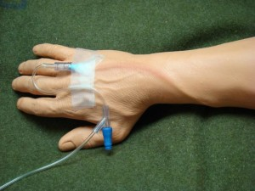
Phlebitis
Inflammation of the wall of superficial veins
Manifestations = Pain, tenderness, warmth, erythema, swelling, palpable cord
Risk factors = mechanical irritation (IV catheter), infusion of irritating medications
Resolves quickly after catheter removal (rarely infectious)
Elevate extremity to decrease edema
Apply warm, moist heat
Administer NSAIDs or topical NSAIDs to relieve pain and inflammation

Slide 2
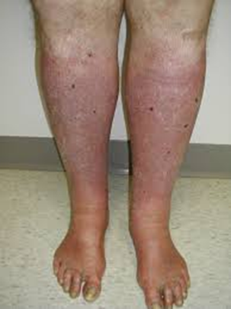
Venous Insufficiency
Caused by prolonged venous hypertension that stretches the veins and damages the valves
Veins and valves fail to keep blood moving forward
Focus of treatment = decrease edema and promote venous return

Slide 3
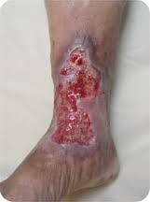
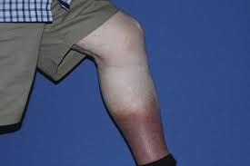
Clinical Manifestations
Edema
Reddish brown skin discoloration along ankles, extending up to the calf
-Venous hypertension causes serous fluid and RBCs to leak from the capillaries and venules into the tissues, causing edema and chronic inflammatory changes. Enzymes in the tissue break down RBCs causing the release of hemosiderin, which causes the brown discoloration
Eczema “stasis dermatitis”
Venous ulcers

Slide 4
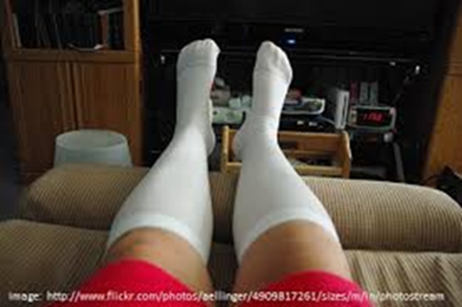
Management of Venous Insufficiency
Elevate legs for at least 20 min 5x a day
When in bed elevate above heart.
Avoid trauma to the limbs.
Daily moisturizing
Avoid prolonged sitting or standing.
Do not cross legs (can cross at ankles for short periods of time).
Do not wear tight, restrictive pants. Avoid girdles and garters.
Wear Compression stockings as prescribed

Slide 5
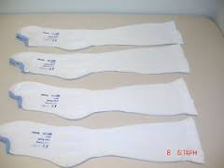
Graduated Compression Stockings (Ted hose)
Wear graduated compression stockings as prescribed (usually during day and evening).
Select the correct size (use sizing chart) to obtain the best fit
When applying stockings, do not “bunch up” and apply like socks. Instead place hand inside stocking and pull out the heel. Then place the foot of the stocking over the foot and slide the rest of the stocking up. Be sure that rough seems on the stocking are on the outside and not next to the skin.
Do not push stockings down because may act like tourniquet and further impair venous return
Put on clean pair of stockings each day. If appear stretched out, replace them with a new pair.

Slide 6
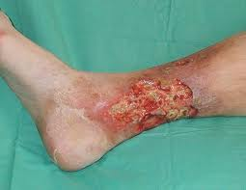
Venous Ulcers (Venous Stasis Ulcers)
Classically located above the medial malleolus
Irregular borders
Painful (especially when edema or infection is present)
Usually chronic and difficult to heal
If left untreated wound becomes deeper and wider (increasing risk for infection, with severe complication = osteomyelitis)

Slide 7
Treatment of Chronic Venous ulcers
Moist dressings
transparent film dressings (duoderm),hydrocolloids, hydrogels, foams, alginates, gauze, and combination dressings
Compression therapy
SCDs
Tubular support bandages
Unna boot – gauze moistened with zinc oxide then covered with elastic wrap that hardens like a cast (provides sterile environment for the ulcer)
Chemical (Accuzyme) or surgical debridement
Diet to promote healing
Adequate protein, calories, and nutrients
Antibiotics only if infection present

Slide 8
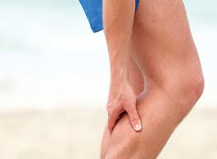
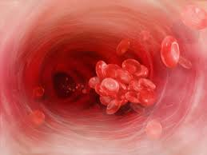
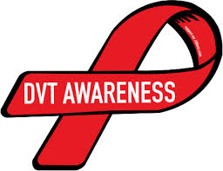
Venous Thromboembolism
Short videos to watch:
https://www.youtube.com/watch?v=uS1RGbW8UbQ
https://www.youtube.com/watch?v=BalkZF8sG7o

Slide 9
Formation of a thrombus in association with inflammation of the vein
Superficial Vein Thrombosis = considered a benign disorder with increased risk for deep vein thrombosis
Deep Vein Thrombosis (DVT)
Venous Thromboembolism (VTE) = now preferred terminology, which includes both DVT and PE (Pulmonary embolism)
Vichow’s triad =
1. Venous stasis
2. Damage of the endothelium (inner lining of the vein)
3. Hypercoagulability of the blood

Slide 10
Risk Factors:
Venous stasis = occurs when dysfunctional valves or muscles of extremities are inactive
obesity, pregnancy, chronic heart failure, traveling on long trips without regular movement/ exercise, prolonged surgical procedure, or are immobile for long periods (spinal cord injury, fractured hip, limb paralysis)
Endothelial damage = damage to endothelium of the vein
surgery, IV, trauma, burns, chemotherapy, diabetes, sepsis
Hypercoagulability of Blood
severe anemias, polycythemia, malignancies, nephrotic syndrome, sepsis, medications (corticosteroids, estrogens – oral contraceptives)

Slide 11
Prevention and Prophylaxis
Do not smoke with oral contraceptives
Stay adequately hydrated
Exercise legs during long periods of rest/ sitting
VTE prophylaxis = a core measure of high-quality health care in hospitalized and surgical patients
Mechanical
Sequential Compression devices (SCDs), Venous Plexi foot pumps
Early ambulation
Graduated Compression Stockings
Chemical
Lovenox, arixtra, or heparin

Slide 12
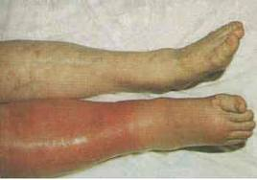
Clinical Manifestations
Unilateral leg edema
Pain, tenderness with palpation
Dilated superficial veins
Sense of fullness in thigh or calf
Paresthesias
Warm skin
Erythema
Systemic temp > 100.4
Pain in calf on dorsiflexion (Homan’s Sign) – no longer performed secondary to potential for dislodging clot and false positives

Slide 13
Complications
Post-thrombotic syndrome – vessel damage and persistent venous obstruction cause persistent edema, increased pigmentation, eczema, secondary varicosisites, and risk of venous ulceration
Pulmonary embolism
Stroke

Slide 14
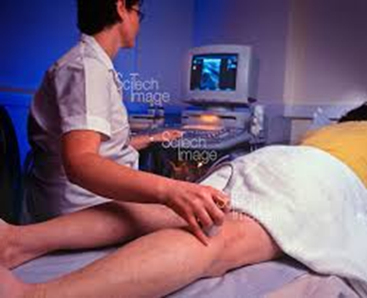
Diagnostics
Venous Duplex Ultrasonography
D-Dimer
Doppler flow studies
MRI – looking for DVT in inferior vena cava or pelvic veins

Slide 15
Management
Rest & Pain relief
Elevation of the affected extremity
Graduated compression stockings
Warm moist soaks
Do not massage area (prevent clot from dislodging)
Anticoagulants (heparin or low-molecular weight heparin and warfarin)
Less common management:
Thrombolytic therapy
Surgical management
Thrombectomy
Inferior vena cava filter (for recurring DVTs)

Slide 16
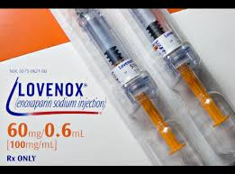
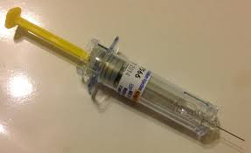
Lovenox (Low Molecular Weight Heparin)
Now preferred over unfractionated heparin therapy secondary to longer half-life and more predictable response
Inhibit thrombin formation because of reduced factor IIa activity and enhanced inhibition of factor Xa and thrombin
Usual dose = 1mg/kg every 12 hours
Subcutaneous injection
Do not require ongoing anticoagulant monitoring and dose adjustment

Slide 17
Coumadin (Warfarin)
Works in the liver to inhibits activation of the four vitamin K-dependent clotting factors II, VII, IX, and X
Taken once daily in evening
Patients started on low doses (5mg) and titrated up as needed
Takes several or more days to take effect – thus overlap of heparin or lovenox and warfarin is typically required for 5 days
Therapeutic INR level between 2 and 3

Slide 18
Coumadin Patient Teaching
Signs/ Symptoms of bleeding
Bleeding gums
Black tarry stools or blood in stools
Blood in urine
Coffee ground emesis, blood in emesis
Use electric razors, not straight razors
Humidify O2
Use soft toothbrushes
Safety precautions to prevent falls

Slide 19
Coumadin Patient Teaching cont.
Inform all healthcare providers (dentist) of anticoagulation therapy
Have blood drawn/ follow up with indicated by healthcare provider
Diet
Eat small amounts of foods high in vitamin K (or keep intake of foods high in vitamin K consistent) – broccoli, cauliflower, spinach, kale, green leafy vegetables, brussel sprouts, cabbage, liver
Avoid cranberry juice

