Slide 1
Peripheral Artery Disease (PAD)
Thickening of the artery walls, which results in a progressive narrowing of the arteries of the upper and lower extremities
Reference: Lewis, S.L., Dirksen, S.R., Heitkemper, M.M, & Bucher, L. (2014). Medical surgical nursing: Assessment and management of clinical problems (9th ed.). St. Louis, MO. Elsevier.

Slide 2
Risk Factors
Risk increases with age
Diabetes Mellitus
Women
Non-Hispanic African American
Other cardiovascular disease
hyperlipidemia, hypertension, smoking, obesity, sedentary lifestyle, stress, hypertriglyceridemia

Slide 3
Atherosclerosis
Leading cause of PAD
Thickening of the artery walls
Results from deposit of cholesterol and lipids within vessel walls
Progressive narrowing of the artery
Inflammation and endothelial injury

Slide 4
Clinical Manifestations
Intermittent claudication
Ischemic muscle pain (anaerobic metabolism
and lactic acid build up)
Caused by exercise
Resolves within 10 min or less with rest
Is reproducible
Paresthesia
Numbness or tingling in the toes or feet

Slide 5
Clinical Manifestations
Skin changes
Thin, shiny, taut
Hair loss on lower legs
Elevation pallor (blanching of foot in response to leg elevation)
Dependent rubor (redness of foot when limb is in a dependent position)
Pulses diminished or absent
Extended capillary refill

Slide 6
Clinical Manifestations
Pain at rest with progressive PAD involving multiple arterial segments
Blood flow is insufficient in meeting basic metabolic requirements of the distal tissues
Occurs more often at night because of decreased CO during sleep and limbs at level of heart

Slide 7
Clinical Manifestations
Prolonged ischemia leads to atrophy of the skin and underlying muscles
Delayed healing, wound infection, and tissue necrosis with injury
Gangrene
Ulceration
Most often found on toes, feet and lower legs
Rounded, smooth (looks like punch out)
Minimal to no drainage, black eschar or pale pink granulation

Slide 8
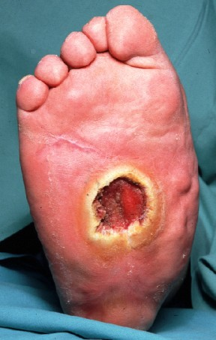
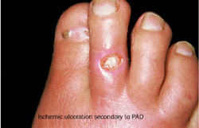
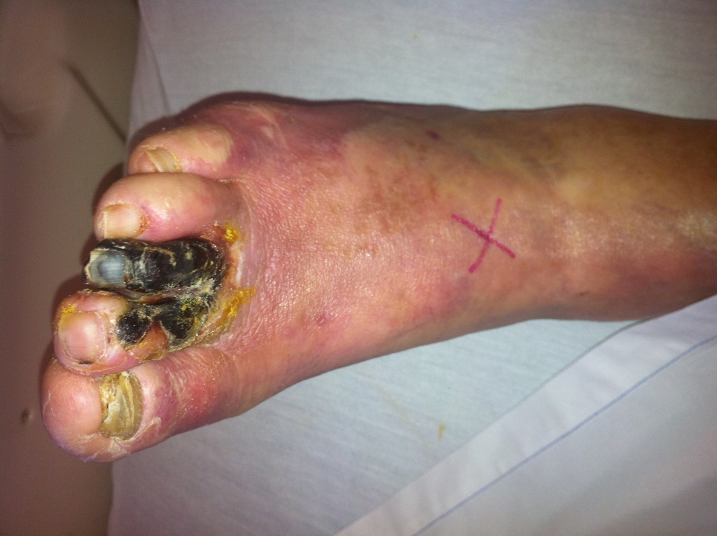
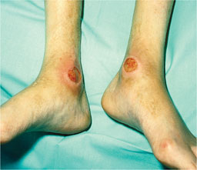
Arterial Ulcers
Toe Gangrene (secondary to PAD)

Slide 9
Clinical Manifestations
Critical Limb Ischemia
Chronic ischemia rest pain lasting more than 2 weeks with presence of arterial ulcers or gangrene from PAD
Amputation is possible due to gangrene or necrotic tissue secondary to decreased circulation

Slide 10
Diagnostics
Palpation of pulses, Doppler pulse
Angiography
Doppler ultrasound (blood flow mapping imagery)
Segmental BPs (using BP cuff and Doppler US) take BP at thigh, below the knee, and at ankle level as patient is supine. Drop in 30 mm Hg suggests PAD
Ankle-brachial index (ABI)
Use a hand-held Doppler
Divide ankle systolic BPs by the higher of the left and right brachial systolic BPs (see Table 38-2 p. 836)

Slide 11
Collaborative Care
Risk factor Modification
Health Promotion!
i.e. Diet (DASH diet), exercise, no smoking, weight loss for obesity
Control DM, hypertension, hyperlipidemia
Drug Therapy
Antiplatelet therapy - aspirin or clopidogrel (Plavix)
Drug therapy to control DM, hypertension, hyperlipidemia

Slide 12
Collaborative Care
Exercise Therapy (exercise program)
Nutrition
Heart healthy diet
Maintain or adjust BMI <25 and waist circumference <35 women/ < 40 men
Walking is most effective exercise for PAD
Supervised treadmill walking is a good way to begin therapy
30/60 min 3-5 x a week

Slide 13
Collaborative Care
Interventional Radiology intervention
Percutaneous transluminal angioplasty (Balloon angioplasty)
Stents
Atherectomy (removal of plaques)
Cryoplasty (PTA and cold therapy) – cold limits restenosis by reducing smooth cell activity
Surgical – peripheral artery bypass

Slide 14
Collaborative Care: Critical Limb Ischemia
Revascularization via bypass surgery
Drug therapy = prostanoids, antiplatelet therapy, drugs to reduce risk factors
Protect extremity from trauma and prevent infection
Cleanse skin and lubricate to prevent cracking, avoid soaking
Soft, roomy, and protective footwear

