Slide 1
Disseminated Intravascular Coagulation
DIC

Slide 2
DIC
DIC is a serious disorder in which the proteins that control blood clotting become over active.
Small blood clots form in the blood vessels. Some of these clots can clog the vessels and cut off blood supply to organs such as the liver, brain, or kidneys. Lack of blood flow can do what to these organs?
Over time, the clotting proteins get used up. This creates a high risk of serious bleeding, even from a minor injury or without injury or spontaneously. The disease can also cause healthy red blood cells to break up when they travel through the small vessels that are filled with clots.

Slide 3
DIC Risk Factors
Blood transfusion reaction
Cancer, especially certain types of leukemia
Pancreatitis
Septicemia
Liver disease
Pregnancy complications (such as placenta that is left behind after delivery)
Recent surgery or anesthesia
Severe tissue injury (as in burns and head injury)

Slide 4
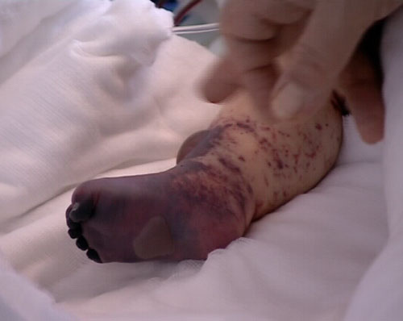
DIC Symptoms
Bleeding, possibly from many sites in the body
Blood clots
Bruising
Drop in blood pressure

Slide 5
Clinical Manifestations
Integumentary: pallor, petechiae, purpura, oozing from sites
Respiratory: tachypnea, hemoptysis, orthopnea
CV: tachycardia and hypotension
GI: upper and lower bleeding, abd distention, bloody stools
GU: hematuria
Neuro: vision changes, dizzy, change in mental status, irritability
Musculoskeletal: join and bone pain

Slide 6
DIC Diagnostics and Treatment
CBC
PT, PTT (increased)
There is no specific treatment and goal is to determine and treat the underlying cause .
Supportive treatments may include:
Plasma transfusions to replace blood clotting factors if a large amount of bleeding is occurring
Heparin to prevent blood clotting if a large amount of clotting is occurring

