Slide 1
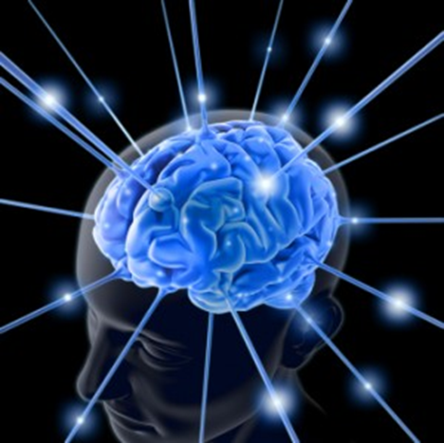
Problems of the CNS: The Brain

Slide 2
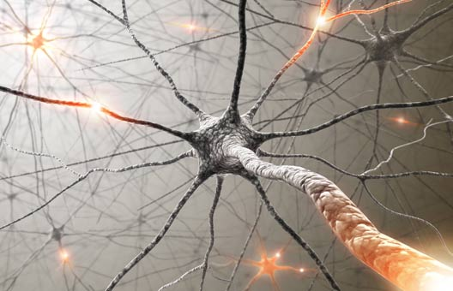
Neuro Review

Slide 3
Assessment
Common complaints: Change LOC, confusion, dizziness, gait disturbances, HA
What are some basic questions you will ask?
PMH & family history
What are some changes associated with aging you may see?
Physical assessment includes what?
Various diagnostics p 1352
Notes:
What are some basic questions you will ask?
When did problem start, how often does it occur?
What factors precipitate/exacerbate?
What alleviates the problem?
Any other symptoms accompany this problem?
Any adverse reactions from treatment of the problem?
Changes with aging:
Decreased agility
Decreased senses (hearing, vision, taste, smell)
Tremors, diminished reflexes, slowed reaction time
Physical assessment includes what?
Mental status and speech, cranial nerves, sensory and motor function, reflexes
Remember that looking at and talking with your patient helps you to assess speech, LOC, hearing, gaze, eye movements quickly

Slide 4
Rapid Neuro Assessment
Glasgow Coma Scale
Response to painful stimuli
Level of consciousness
Decorticate posturing
Decerebrate posturing
Notes:
GCS: eye, verbal, motor
Painful stimuli- central more accurate then peripheral (nailbed) central may be sternal rub, trapezius squeeze
LOC- even a subtle change is the first indicator of a decline in neurologic status
Decorticate- arms are bent in toward the body and the wrists and fingers are bent and held on the chest. Sign of damage to the nerve pathway between the brain and spinal cord.
Decerebrate- more serious, signifies damage to brain, arms and legs being held straight out, the toes being pointed downward, and the head and neck being arched backward.

Slide 5
Diagnostics
Cerebral angiograpy
Cerebral CT scan- gross abnormalities, bleeds, bone detail
Electroencephalography- no stimulates or sedatives prior
LP
MRI-More soft tissue, different protocols depending on concern
CT Contrast: Iodine, shellfish, if >60 or diabetic need Creatinine last 42-78 hours,
MRI same but more screening with magnet issues including a GFR
R/O stroke- CT first look for active bleed
Notes:
Cerebral angiography- looks at blood flow thru brain (aneurysm)
Cerebral CT scan- looks at cranial cavity to identify tumors, infarctions, guide needle biopsy
Electroencephalography- looks at electrical activity of the brain and anomalies in brain wave activity
LP- small amount of CSF is withdrawn from spinal canal and analyzed
MRI- cranial cavity, contrast media enhances images, can discriminate soft tissue from bone, makes determining tumor size and blood vessels location more effective. no pacemaker can change pacing (contraindicated so do CT instead) any magnetic implants can move implant. Beginning to use more 3.0 magnet, which picks up cars. Oxygen tanks/ guerney MRI compatable, f using contrast allergic to gadolium, no jewelry or metal to prevent damage to themselves, has claustrophobia? Any metal in body
Stroke- CT first look for active bleed, quicker, always have tech, then f/u with MRI next day within 24 hours for damage MRI sees stroke sooner, many places do not have MRI tech on board, so first ruling bleed to guide therapy, happens in rural

Slide 6
The type of HA most nursing students have experienced?

Slide 7
Tension HA
Constant dull pressure, band like tightening
May have sensitivity to light or sounds
Careful history taking

Slide 8
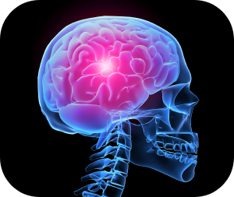
Migraine
What are some unique characteristics?

Slide 9
Migraine
Migraines with aura
Migraines without aura
Diagnostics?
Notes:
With aura- classic migraine- visual, sensory, motor, or prodrome phase which is neurologic, psychologic. Early warning of impending migraine with aura usually consists of visual changes, flashing lights, or diplopia.
Without aura- common migraine-
Atypical migraine which is typical in healthcare overall

Slide 10
Migraine
Diagnostics usually based on patient history, no specific lab or rad tests unless abnormal neurological exam.

Slide 11
Cluster HA
Brief intense unilateral pain usually without warning. Most common chronic short duration HA. Attacks occur in clusters that usually lasts 2 weeks to 3 months.
Clinical manifestations
Ipsilateral tearing of eye
rhinorrhea or congestion
Eyelid edema
Facial flushing or pallor
Notes:
Rhinorrhea refers to a thin, relatively clear nasal discharge

Slide 12
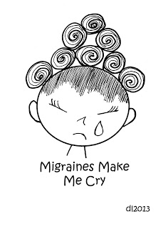
Drug Therapy
Why antiemetics?
Nonopioid (Ibuprofen, Tylenol)
How does triptan preparations help?
Caffeine
Beta-blockers, CCB, antiepileptic meds
Botox
Notes:
Abortive/symptomatic meds
Antiemetics (reglan)- relieve N/V
Nonopioid- Sometimes can have rebound headaches if overuse nonopioid
Triptan- produce vasoconstriction,
Caffeine- vasoconstrict
Preventative meds- (These drugs are thought to have an impact on neurotransmitters and may also block electrical signals in nerve and brain cells
BB- blocks vasodilation
CCC- used if cant use BB, not really sure how it works, tends to vasodilate
Antiepileptic- suppresses events leading to migraine, enhances GABA (neurotransmitter) transmission
Botox- calms muscle contractions by blocking transmission of nerve pulses.

Slide 13
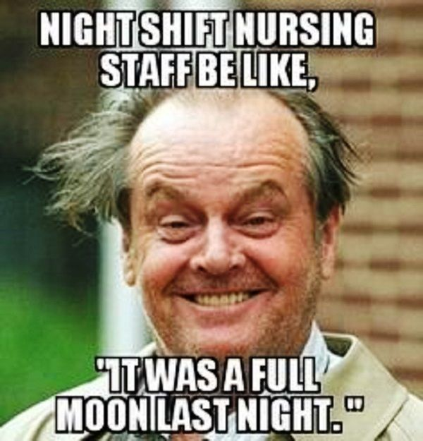
Migraines
Migraines: Not just another headache
https://www.youtube.com/watch?v=N8TzqrRbPlY

Slide 14
Meningitis
Inflammation of meninges around brain and spinal cord
Viral usually self-limiting with complete recovery
Bacterial potentially life threatening
Meningococcal meningitis emergency with high mortality rate. Occurs in outbreaks in highly populated areas, very contagious.
What are some common assessment findings?

Slide 15
Clinical Manifestations
Most common
N/V
Fever
Severe HA
Nuchal rigidity (stiff neck)
Potential
LOC decreasing
Shock s/s- decreased BP is red flag
Increasing intracranial pressure (most common complication)
Photophobia
Skin rash and petechiae if organism is meningococcus

Slide 16
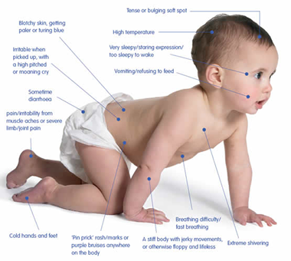
Meningitis
What are your nursing interventions?

Slide 17
Meningitis Table 57-17 p 1382
Neurologic assessment
Cranial nerves II, III, IV, V, VI, VII, VIII
Antibiotics
Vascular assessment
Diagnostics
History and physical
Cultures before antibiotics
CT, MRI
CSF

Slide 18
Collaborative Care
ABC
VS and neuro q2 hours
Cranial nerves
Pain control- this is HUGE
I/O, labs, LP
Environmental
Prevent complications (seizures, ICP, FE imbalance, shock)
Immunizations
Droplet precautions

Slide 19
Labs
CBC- elevated
Urine, throat, nose, and blood cultures and sensitivities
CSF analysis- Most definitive
Fluid cloudy (bacterial) clear (viral)
Elevated WBC, protein, CSF pressure
Decreased glucose (bacterial)
CT scan and MRI- R/O ICP
Notes:
Cultures- not definitive for meningitis, but can guide antibiotic therapy for infectious bacteria
CSF- Increased CSF protein may be due to blood in the CSF, diabetes, polyneuritis, tumor, injury, or any inflammatory or infectious condition, decreased glucose due to the CNS infection

Slide 20
Health Promotion/Disease Prevention: Immunize
Haemophilus influenza type b (Hib)- infants, 4 doses, begin at 2 month ends at 12-15 months
Pneumococcal polysaccharide vaccine (PPSV)- intended to prevent respiratory infection, also decrease CNS infections. One does to adults > 65 who have not been previously immunized
Meningococcal vaccine (MCV4)- adolescents, need prior to college, initial dose 11-12 years with booster at 16.
Notes:
The Neisseria meningitidesvaccination is recommended for children ages 11 and 12, unvaccinated teens entering high school, and college freshmen. Hand washing may help decrease the spread of bacteria, but it is not as effective as immunization. Vaccination with Haemophilus influenzae is for infants and toddlers. Because adolescents and young adults are in school or the workplace, avoiding crowds is not realistic.

Slide 21
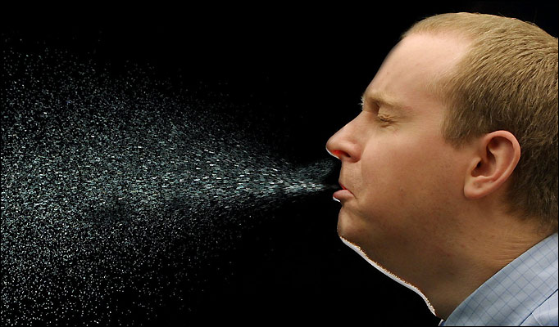
What are Droplet precautions again……check out CDC
Pathogens transmitted by droplets
Flu, RSV, Meningitis
Mask, gloves, gown, goggles if substantial spraying of resp fluids

Slide 22
Encephalitis
Inflammation of the brain. Viral infections are the most common cause of the condition. West Nile virus is an example.
Encephalitis can cause flu-like symptoms, such as a fever or severe headache, as well as confused thinking, seizures, or problems with senses or movement. Many cases of encephalitis may go unnoticed because they result in only mild flu-like symptoms or even no symptoms. Severe cases of encephalitis, while relatively rare, can be life-threatening.

Slide 23
Encephalitis
Assessment
LOC, fatigue, symptoms of ICP, joint pain, HA, vertigo, nuchal rigidity
Seizures common
Muscle tremors, gait issues,
Lumbar puncture

Slide 24
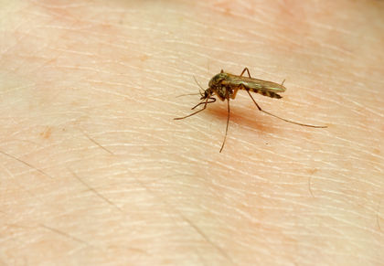
Encephalitis
HSV
Mosquito-borne viruses
Tick-borne viruses
Rabies
Childhood infections such as MMR

Slide 25
Drug Therapy
Antiviral drugs
More-serious cases of encephalitis usually require aggressive antiviral treatments. Antiviral drugs commonly used to treat encephalitis include:
Acyclovir (Zovirax)
Ganciclovir (Cytovene)
Some viruses, such as insect-borne viruses, don't respond to these treatments. However, because the specific virus causing the infection may not be identified immediately or at all, treatment with acyclovir is often begun immediately. This drug can be effective against the herpes simplex virus, which can result in significant complications or death when not treated promptly.

Slide 26
Parkinson’s
How Parkinson's Disease Affects the Body -- The Doctors
https://www.youtube.com/watch?v=hu4eTijdIv0

Slide 27
Parkinson Disease
Progressive disorder of the nervous system that affects your movement. It develops gradually, sometimes starting with a barely noticeable tremor in just one hand. It also commonly causes stiffness or slowing of movement.
In early stages face may show little or no expression, or arms may not swing when you walk. Speech may become soft or slurred. Parkinson's disease symptoms worsen as condition progresses over time.
Cannot be cured but medications may markedly improve symptoms.
What are some s/s of Parkinson’s

Slide 28
Parkinson Disease
Tremor. Back-and-forth rubbing of thumb and forefinger, known as a pill-rolling tremor. One characteristic of Parkinson's disease is tremor of hand when it is relaxed (at rest).
Slowed movement (bradykinesia)
Rigid muscles in any parts of body. The stiff muscles can limit range of motion and cause pain.
Posture may become stooped, or patient has balance problems.

Slide 29
Parkinson Disease
Loss of automatic movements. Decreased ability to perform unconscious movements, including blinking, smiling or swinging your arms when you walk. May no longer gesture when talking.
Speech changes. May speak softly, quickly, slur or hesitate before talking. Speech may be more of a monotone, rather than with the usual inflections.
Writing changes. Writing may appear small and become difficult.
Decreased Dopamine levels in brain leads to lose of ability to refine voluntary movement.

Slide 30
Drug Therapy- See handout
Each person must be individually evaluated to determine which drug or combination of drugs is best for them
Choice of drug treatment depends on many variables including symptom presentation, other concurrent health issues (and the medications being used to treat them) and a person’s age.

Slide 31
Drug Therapy
Carbidopa-levodopa (Sinemet). Most effective Parkinson's disease medication, is a natural chemical that passes into your brain and is converted to dopamine. Levodopa is combined with carbidopa, which protects levodopa from premature conversion to dopamine outside your brain. Over time starts wearing off. Dyskinesia (involuntary muscle movement) and impaired voluntary movement may occur with high dosages. Nausea, anorexia, dizziness, orthostatic hypotension, bradycardia, and akinesia are frequent side effects of the medication.
Dopamine agonists. Mimic dopamine effects in brain. Not as effective in treating symptoms as levodopa. However, last longer and may be used with levodopa to smooth the sometimes off and on effect of levodopa. Side effects similar to carbidopa-levodopa.

Slide 32
Drug Therapy
MAO B inhibitors. Help prevent the breakdown of brain dopamine by inhibiting the brain enzyme monoamine oxidase B (MAO B). This enzyme metabolizes brain dopamine. Side effects are uncommon, but may rarely include nausea or headaches. When added to carbidopa-levodopa, these medications can increase the risk of hallucinations. These medications can't be used in combination with most antidepressants or certain narcotics, due to potentially serious reactions.
Amantadine. Can be prescribed alone to provide short-term relief of symptoms of mild, early-stage Parkinson's disease. It also may be added to carbidopa-levodopa therapy for people in the later stages of Parkinson's disease, to help control involuntary movements (dyskinesia) induced by carbidopa-levodopa. Side effects may include a purple mottling of the skin, ankle swelling or hallucinations.

