Slide 1
Gastroesophageal
Reflux Disease (GERD)

Slide 2
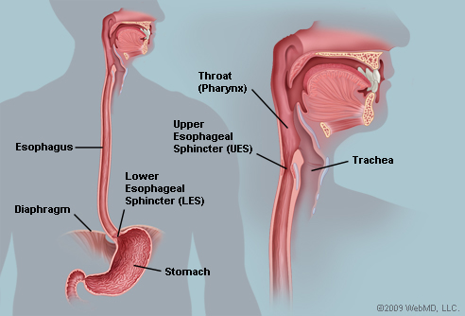

Slide 3
Pathophysiology:
Esophageal tissue exposed to gastric or duodenal contents = irritation and inflammation (esophagitis)
PH stomach = 1.5 to 2.0
  vs. PH of the distal esophagus 6.0 to 7.0
*Esophagus has Limited resistance to damaging effects of acid
Notes:
Pregnancy, wearing tight belts or girdles, bending over, ascites, obesity, obstructive hiatal hernias = increase intra-abdominal pressure contributing to reflux of stomach contents into the esophagus
**Cigarette and cigar smoking, fatty foods, caffeinated beverages, chocolate, citrus fruits, tomatoes and tomato products, calcium channel blockers, nitrates, peppermint, spearmint, alcohol, anticholinergic drugs, high levels of estrogen and progesterone, nasogastric tube placement = weaken lower esophageal sphincter tone.
Nighttime reflux
Scarring tissue – can cause esophageal stricture

Slide 4
Pathophysiology:
Incompetent Lower Esophageal Sphincter (LES) = most common cause (Table 42-7 p. 932)
1. Due to increased intra abdominal pressure
  Pregnancy, wearing tight belts or girdles, ascites, obesity, hiatal hernias
2. Decreased LES pressure
  Foods (Caffeine, fatty foods, chocolate, alcohol, peppermint)
  Beta-blockers, calcium channel blockers, morphine, nitrates, progesterone
  Smoking
Notes:
Pregnancy, wearing tight belts or girdles, bending over, ascites, obesity, obstructive hiatal hernias = increase intra-abdominal pressure contributing to reflux of stomach contents into the esophagus
**Cigarette and cigar smoking, fatty foods, caffeinated beverages, chocolate, citrus fruits, tomatoes and tomato products, calcium channel blockers, nitrates, peppermint, spearmint, alcohol, anticholinergic drugs, high levels of estrogen and progesterone, nasogastric tube placement = weaken lower esophageal sphincter tone.
Nighttime reflux
Scarring tissue – can cause esophageal stricture

Slide 5
Clinical Manifestations:
Pyrosis – “Heartburn”
Dyspepsia – Upper abdominal discomfort
Regurgitation – Risk for aspiration Pneumonia
Otolaryngologic symptoms: cough, hoarsness, sore throat, choking, sense of lump in throat, bronchospasm, laryngospasm
Chest pain – can mimic angina (cardiac chest pain)
Notes:
Worsens with bending lying down or straining. Relief by sitting up, drinking fluids, taking antacids. (burning sensation that tends to move up and down the chest in a wavelike fashion – severe pain that may radiate to the neck or jaw and may refer to the back)
Severe GERD pain after every meal lasting 20min to 2 hrs

Slide 6
Complications:
Esophagitis with esophageal ulcers
Esophageal stricture - Dysphagia or odynophagia (painful swallowing)
Barrett’s esophagus – cell changes in lower esophagus
*considered a precancerous lesion that increases risk for esophageal adenocarcinoma
Notes:
Worsens with bending lying down or straining. Relief by sitting up, drinking fluids, taking antacids. (burning sensation that tends to move up and down the chest in a wavelike fashion – severe pain that may radiate to the neck or jaw and may refer to the back)
Severe GERD pain after every meal lasting 20min to 2 hrs

Slide 7
Lifestyle Modifications:
Teach patient to pay attention to and avoid triggers: such as different drugs and foods that may affect LES, acid secretion, or gastric emptying
Weight reduction if patient is overweight
Low fat diet
Avoid peppermint, chocolate
Eating small frequent meals to prevent gastric distention
Avoid alcohol, smoking, caffeine, & carbonated beverages
Do not lie down for 2-3 hours after eating
Do not wear tight clothing around the waist or bend over (Esp. after eating)
Elevate bed while sleeping on 6 to 12 inch blocks, sleep on right side

Slide 8
Drug Therapy:
Decreasing
Volume and acidity of reflux
  PPIs, H2-receptor blockers (PPIs = more effective in healing esophagitis) = decrease acid production
  Antacids = neutralize HCL acid
Improving LES function
  Cholinergic drugs (can also increase acid)
3. Protecting Esophageal mucosa
  Antiulcer protectants
  Prostaglandin

Slide 9
Drug Therapy:
Gastric Juices -
Acid secretion by parietal cells in presence of histamine is stimulated by acetylcholine (neurotransmitter), gastrin and histamine
Acetacholine and gastrin stimulate chief cells to release pepsinogen during eating, which is quickly converted to pepsin in the acidic environment of the stomach (pH of 2). Pepsin is inactive/deactivates in an alkaline environment. Pepsin breaks down proteins.

Slide 10
Drug Therapy
PPIs and H2 receptor blockers = common and effective. PPIs more effective in healing esophagitis than H2 blockers as well as decreasing evidence of esophageal strictures

Slide 12
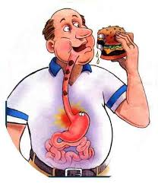
What should we teach our patients with GERD?
HOB 30 degrees (elevate bed at home on blocks), teach to have smaller frequent meals, no fatty foods, no alcohol, no carbonated beverages, no spicy foods, no acidic foods/ beverages (tomatoes, orange juice), avoid chocolate, no smoking/nicotine, avoid peppermint/ spearmint, Take PPIs before meals each day, H2 receptor blocker – take med as prescribed and do not stop med without checking with healthcare provider, for 2-3 hours after a meal patient should not be supine, Discuss strategies for weight reduction if needed

Slide 13
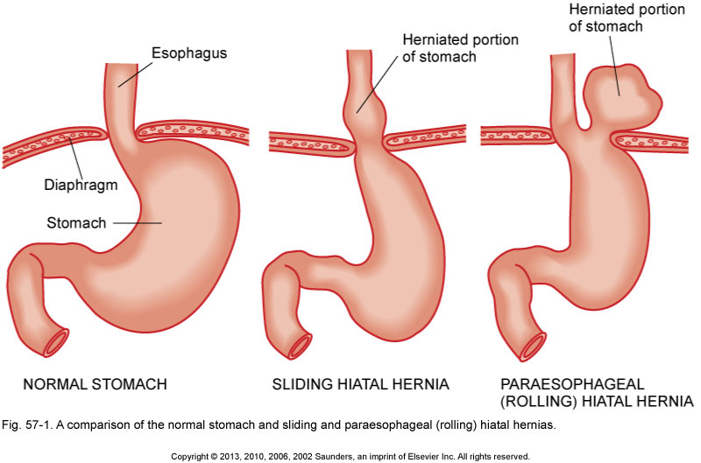
Hiatal Hernia
Sliding Hernia
  Reflux – GERD symptoms
  Belching
  Dysphagia
Rolling (paraesophageal) Hernia
  Fullness after eating
  Breathlessness
  Feeling of suffocation
  Chest pain
  Worsening symptoms laying down
  Risk for strangulation/ obstruction

Slide 14
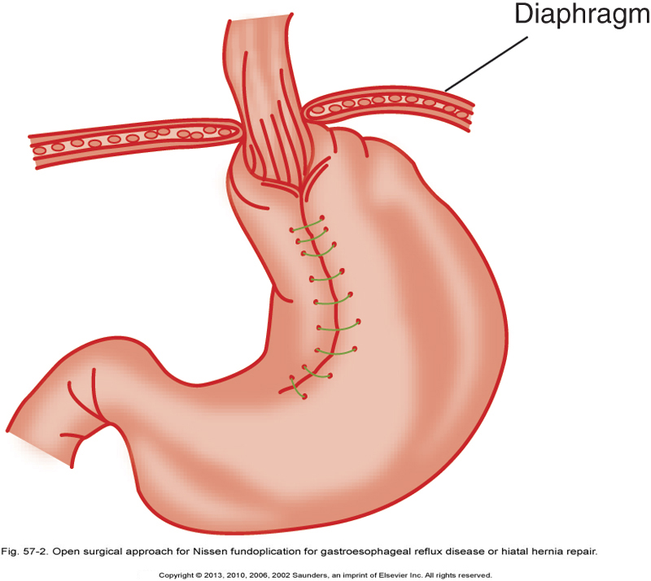
Medical Management = similar to GERD
Herniotomy
Herniorrhapy
Nissen laproscopic techniques

Slide 15
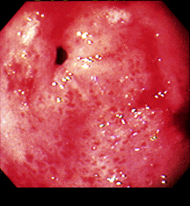
Gastritis
Drug related gastritis
  NSAIDS – inhibit synthesis of prostaglandins
Diet
  Alcohol (binge drinking), eating large amounts of irritating/ spicy foods
Helicobcter Pylori (H-Pylori)
  Fecal oral or oral oral route
  Bacteria produce urease - irritating to lining and activates the immune response with both antibody production and release of inflammatory cytokines

Slide 16
Gastritis - Treatment
Elimination of Irritant
Supportive Therapy:
Vomiting/ dehydration – IV fluids
Nausea – antiemetics
Severe cases – NGT and gastric lavage
Clear liquids with gradual advancement of diet
H2 receptor blockers or PPIs to reduce gastric HCL acid secretion
Smoking Cessation

Slide 17
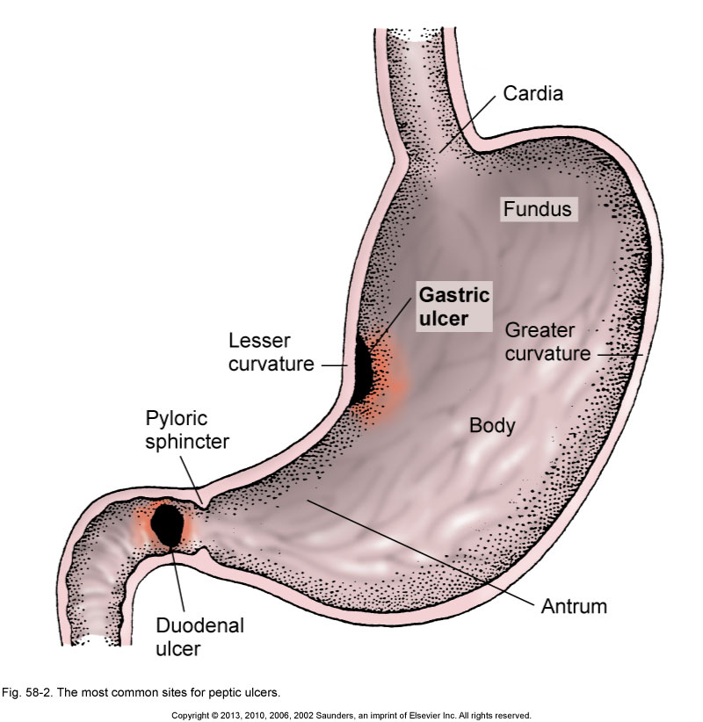
Peptic Ulcer Disease
Gastric Ulcers
Epigastric Pain “burning” or “gaseous” that occurs 1 to 2 hours after eating
Food usually aggravates rather than alleviates the pain.
Duodenal Ulcers
Mid-epigastric pain “burning” “Cramplike” 2 to 5 hours after eating
Silent Peptic Ulcers = no pain, only aware when complications arise

Slide 18
Interventions/ Therapy/ Teaching?

Slide 19
Complications of Ulcers
Hemorrhage (Upper GI Bleed)
  Hematemesis (Bright red or coffee ground emesis)
  Melena (Occult blood, dark tarry stool)
Gastric Outlet Obstruction
obstruction in the distal stomach secondary to edema, inflammation.
Stomach pain, Vomiting, dehydration, constipation (secondary to dehydration).
Perforation
Sudden sharp pain in epigastric region that spreads to entire abdomen
  Peritonitis – abdomen is tender and rigid (Occur within 6-12 hrs)
  Septicemia and hypovolemic shock (tachycardia, weak pulse) (Need IV fluids, and antibiotics)
  Paralytic ileus develops
  Spontaneous closure of a small lesion – can cause strictures, Surgical Emergency of larger lesion

Slide 20
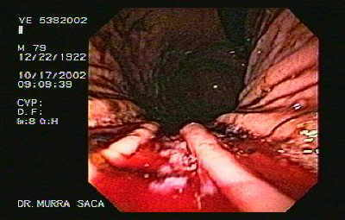
Upper GI Bleed
Hematemesis (Bright red or coffee ground emesis)
Melena (Occult blood, dark tarry stool)
Monitor H/H and VS
Manage hypovolemia – assess fluid status
  Volume replacement with isotonic solution (NS)- GET IV IN
  Prepare for blood transfusion
NGT placement and Gastric lavage (tap
Room temp water)
Endoscopic Therapy

