Slide 1
Gastrointestinal System

Slide 2
Learning is finding out what you already know
-Richard Bach

Slide 3
Assessment
What you already know

Slide 4
Most Common Medications
1
A Review

Slide 5
Most Common Labs
2
A Review

Slide 6
Most Common Diagnostics
3
A Review

Slide 7
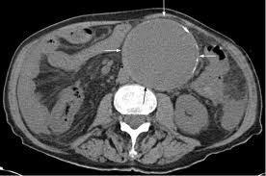
Notes:
AAA. This is a CT of the abdomen without contrast demonstrating a very large abdominal aorta.

Slide 8
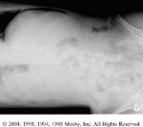

Slide 9
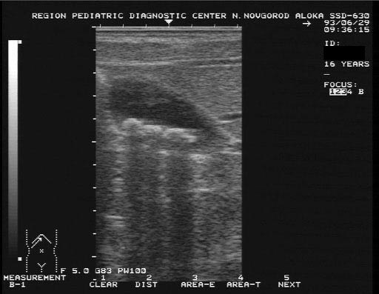
Notes:
US Gallbladder demonstrating stones

Slide 10
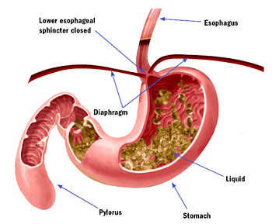
GERD
Assessment
Interventions
Evaluations
Teaching priorities

Slide 11
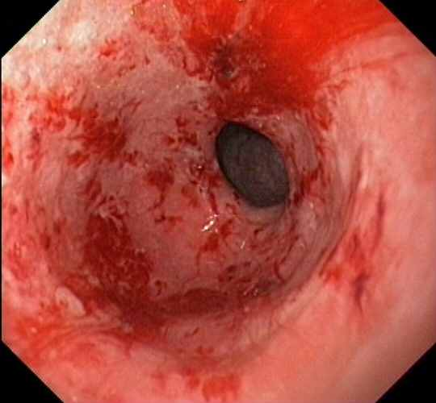
Gastritis
Assessment
Interventions
Evaluations
Teaching priorities

Slide 12
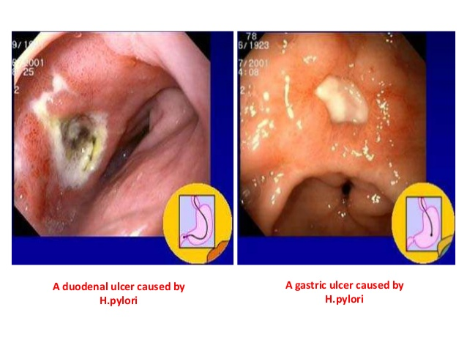
PUD
Assessment
Interventions
Evaluations
Teaching priorities

Slide 13
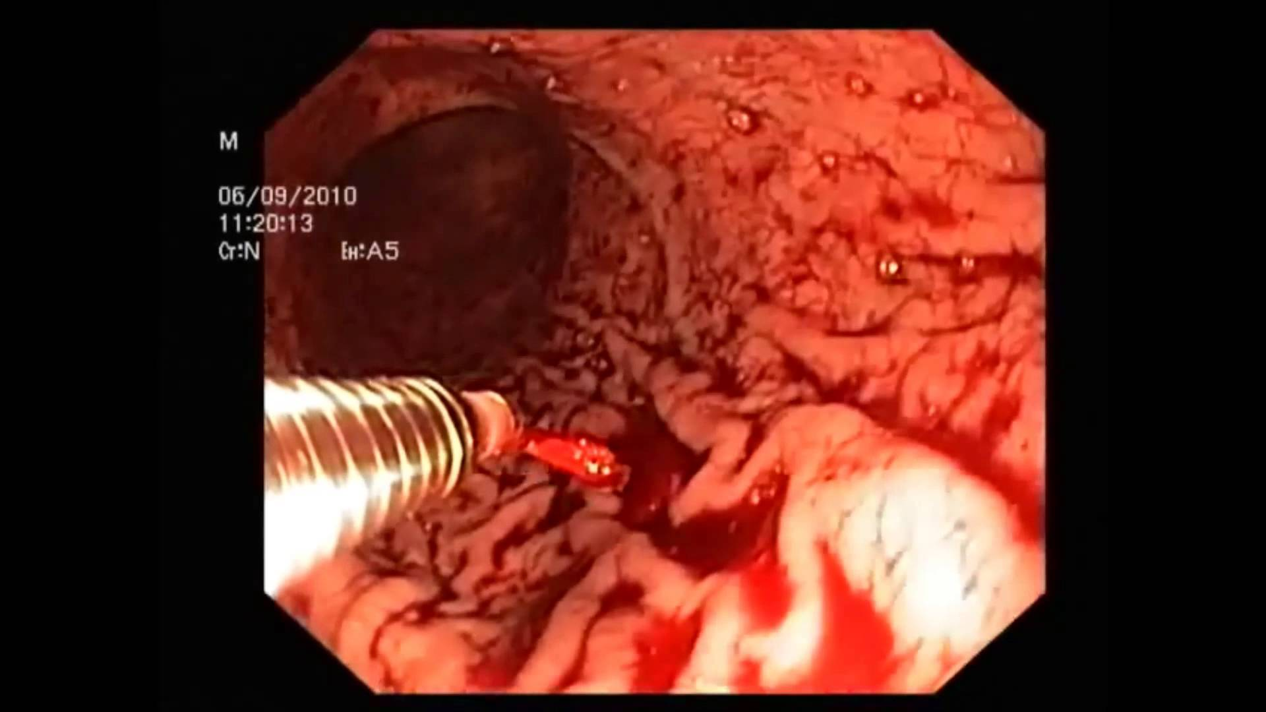
Upper GI Bleed
Assessment
Interventions
Evaluations
Teaching priorities

Slide 14
Food Poisioning
Assessment
Interventions
Evaluations
Teaching priorities

Slide 15
Priorities
Find a partner or two

Slide 17
THANKS!
Any questions?

