Slide 1
GI System

Slide 2
Actor #1

Slide 3
Appendicitis-Underlying cause/pathophysiology
Inflammation of the appendix
The appendix has no known function in the body, but it can become diseased and inflamed and considered and emergency.
If left untreated, the appendix may rupture and cause a potentially fatal infection of the abdominal lining known as peritonitis
Most common in people between the ages of 10 and 30, but it can develop at any age. In a few cases, appendicitis has been diagnosed in newborn babies.

Slide 4
Appendicitis- Underlying cause/pathophysiology
Develops when the lumen (inner cavity) of the appendix is blocked ranging from intestinal parasites to fecal matter to tumors to infection.
As blockage progresses tissues of the appendix begin to die from lack of blood flow. They are then invaded by bacteria and form pus. If the condition is not treated, the appendix swells and eventually bursts, spreading the infection throughout the abdomen=peritonitis
What nursing priorities will guide your plan of care?
What labs and assessments are relevant to this patient? What might we see with VS?

Slide 5
Appendicitis
Pain usually starts two to three days before the appendix gets to the point of bursting, where is McBurney’s point?
Classic symptoms of appendicitis are nausea, vomiting, low-grade fever, and loss of appetite, rebound tenderness (fewer than 50 %)
Children and the elderly are often misdiagnosed because they have fewer of these symptoms; in particular, very young children may be misdiagnosed because they cannot explain or describe their symptoms. As a result, their treatment is often delayed.
Signs of rupture include the presence of symptoms for more than 24 hours, fever, high white blood cell count, tachycardia.
Sudden relief from pain could indicate that appendix has ruptured.
Nursing interventions and why are you performing these?

Slide 6
Appendicitis
Emergency care is as follows
Establish IV access and administer aggressive crystalloid therapy to patients with clinical signs of dehydration or septicemia
Keep patients with suspected appendicitis NPO
Administer parenteral analgesic and antiemetic as needed for patient comfort
Antibiotics
Antibiotic prophylaxis usually administered before every appendectomy
Antibiotic treatment may be stopped when the patient becomes afebrile and the WBC count normalizes

Slide 7
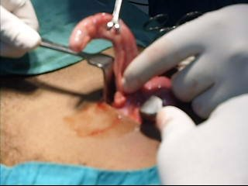
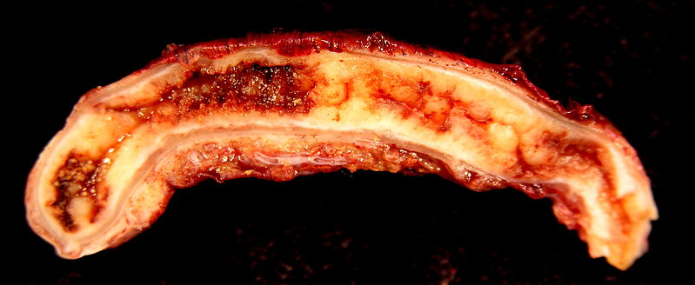
Appendicitis

Slide 8
Q
The nurse is monitoring a client admitted to the hospital with a diagnosis of appendicitis who is scheduled for surgery in 2 hours. The client begins to complain of increased abdominal pain and begins to vomit. On assessment, the nurse notes that the abdomen is distended and bowel sounds are diminished. Which is the most appropriate nursing intervention?
Notify the health care provider (HCP).
Administer the prescribed pain medication.
Call and ask the operating room team to perform the surgery as soon as possible.
Reposition the client and apply a heating pad on the warm setting to the client's abdomen.

Slide 9
A
Notify the health care provider (HCP).
On the basis of the signs and symptoms presented in the question, the nurse should suspect peritonitis and notify the HCP. Administering pain medication is not an appropriate intervention. Heat should never be applied to the abdomen of a client with suspected appendicitis because of the risk of rupture. Scheduling surgical time is not within the scope of nursing practice, although the HCP probably would perform the surgery earlier than the prescheduled time.

Slide 10
Q
The nurse is caring for a client admitted to the hospital with a suspected diagnosis of acute appendicitis. Which laboratory result should the nurse expect to note if the client does have appendicitis?
Leukopenia with a shift to the left
Leukocytosis with a shift to the left
Leukopenia with a shift to the right
Leukocytosis with a shift to the right

Slide 11
A
B. Leukocytosis with a shift to the left
Laboratory findings do not establish the diagnosis of appendicitis, but there is often an elevation of the white blood cell count (leukocytosis) with a shift to the left (an increased number of immature white blood cells).

Slide 12
Q
A client arrives at the hospital emergency department complaining of acute right lower quadrant abdominal pain, and appendicitis is suspected. Laboratory tests are performed, and the nurse notes that the client's white blood cell (WBC) count is elevated. On the basis of these findings, the nurse would question which health care provider's (HCP) prescriptions documented in the client's medical record?
Apply a cold pack to the abdomen.
Administer 30 mL of milk of magnesia (MOM).
Maintain nothing-by-mouth [NPO] status.
Initiate an intravenous (IV) line for the administration of IV fluids.

Slide 13
A
B. Administer 30 mL of milk of magnesia (MOM).
Appendicitis should be suspected in a client with an elevated WBC count complaining of acute right lower abdominal quadrant pain. Laxatives are never prescribed because if appendicitis is present, the effect of the laxative may cause a rupture with resultant peritonitis. Cold packs may be prescribed for comfort. The client would be NPO and given IV fluids in preparation for possible surgery.

Slide 14
Actor #2

Slide 15
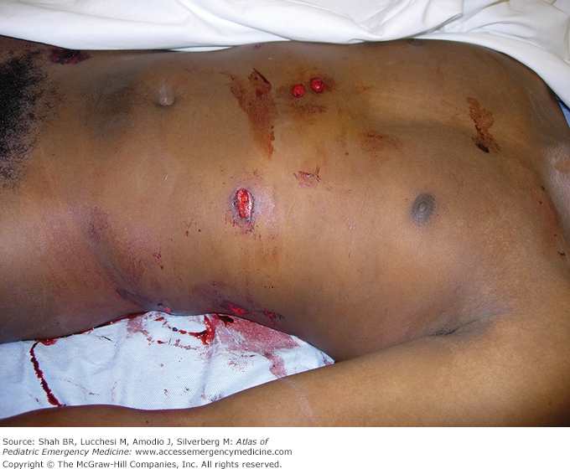
Abdominal Trauma-underlying cause/pathophysiology
Blunt or penetrating- ½ blunt from MVAs and most penetrating from GSWs
What are some relevant assessment findings? Labs? What VS may you see? Why are we worried about patient going into shock? What are your priority interventions?

Slide 16
Priorities
Airway, oxygen
Control bleeding
IVF large bore catheters
Blood type cross and match
Ongoing- LOC, Oxygen sats, and UOP

Slide 17
Abdominal Trauma
Ecchymotic areas could indicate major organ injury so assess for abdominal guarding or rigidity and notify MD. Very important to monitor VS!
Considerations- Objects impaling a patient should not be removed and emergency management for shock is always indicated.
Check VS and get IV started ASAP.
Since bleed not always obvious what are you monitoring for?

Slide 18
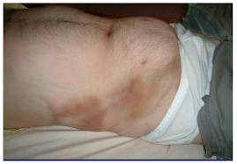
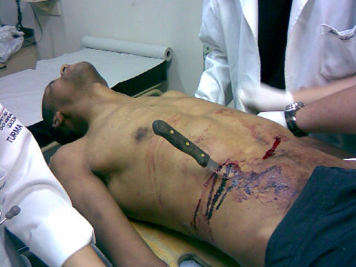
Abdominal Trauma

Slide 19
Actor #3

Slide 20
IBS- pathophysiology
Intestinal condition characterized by abdominal pain and cramps, changes in bowel movements (diarrhea, constipation, or both), gassiness, bloating, nausea, and other symptoms.
There is no cure for IBS. Much about the condition remains unknown or poorly understood; however, dietary changes, drugs, and psychological treatment are often able to eliminate or substantially reduce its symptoms
Symptoms of IBS tend to rise and fall in intensity rather than growing steadily worse over time.
Other symptoms include cramps, gassiness, bloating, nausea, a powerful and uncontrollable urge to defecate (urgency), passage of mucus during bowel movements, or the feeling after finishing a bowel movement that the bowels are not completely empty.
As a nurse what will you focus your teaching on?

Slide 21
IBS
Researchers remain unsure about the cause or causes of IBS but diet and stress appear to play a role among other theories
Low-fat, high-fiber (30-40 grams/day) diet recommended with 8-10 glasses water/day
Problem-causing substances such as lactose, caffeine, beans, cabbage, broccoli, fatty foods, alcohol, and medications should be identified and avoided.
Bran or 15-25 g a day of an over-the-counter psyllium laxative (Metamucil or Fiberall) may also help both constipation and diarrhea. Antidiarrheal agents. Can still have milk or milk products if lactose intolerance is not a problem. People with irregular bowel habits, particularly constipated patients, may be helped by establishing set times for meals and bathroom visits.
Complementary and Alternative Therapies: acupuncture, herbs, peppermint oil, meditation, yoga

Slide 22
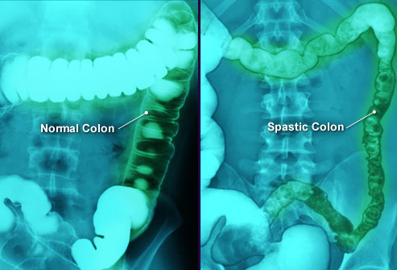
IBS

Slide 23
Actor #4 and #5

Slide 24
Inflammatory Bowel Disease
Crohn’s disease
Ulcerative colitis
Autoimmune disorders characterized by chronic inflammation of intestine with periods of remission and exacerbations.
Unknown cause, no cure
Relies on meds to treat acute inflammation and maintain remission
Surgery for patients who unresponsive to meds or who develop complications.
Toxic megacolon- rare, life-threatening complication of severe colon disease or infection. Diagnosed when your colon has expanded by more than five to six centimeters. Risk for systemic infection, shock, and dehydration.

Slide 25
Inflammatory Bowel Disease
Ulcerative colitis-Inflammation can extend to entire colon but usually rectum and sigmoid.
In severe cases bleeding and ulcerations occur. Abscesses can lead to necrosis.
Stool=blood and mucous. Malaise, anorexia, anemia, dehydration, fever and weight loss.
Colonoscopy- best test to diagnose.
ESR rates (norm 0 to 33) which indicates inflammation elevate during exacerbation, also increase WBC and C-reactive protein (shows inflammation).

Slide 26
Inflammatory Bowel Disease
Crohn's disease causes inflammation anywhere along the lining of your digestive tract, and often spreads deep into affected tissues causing strictures and deep ulcerations. This can lead to crampy abdominal pain, severe diarrhea and malnutrition (since cannot absorb nutrients).
If inflammation goes through bowel wall can leak contents into peritoneal cavity.
Many complications including fistulas, intestinal obstructions, malabsorption
What medications are relevant?

Slide 27
Inflammatory Bowel Disease
Drug therapy includes
Anti-inflammatory
Immune suppressors-These drugs also reduce inflammation, but they target your immune system rather than treating inflammation itself. Because immune suppressors can be effective in treating ulcerative colitis, scientists theorize that damage to digestive tissues is caused by your body's immune response to an invading virus or bacterium or even to your own tissue. By suppressing this response, inflammation is also reduced.
Antibiotics can reduce the amount of drainage and sometimes heal fistulas and abscesses in people with Crohn's disease
Antidiarrheal, pain medication, vit B12, Calcium and Vit D
Biologic (living organisms) and targeted therapy (block growth)
What nursing interventions will you initiate?

Slide 28
IBD Interventions
Rest bowel so NPO status -monitor I/O
Monitor for occult blood in stools, labs
Pain control
Decrease stress
Quit smoking
Skin care
Dietary considerations- correct any malnutrition
Control inflammation
Combat infection
Improve quality of life- psychosocial issues
Hemodynamic stability- potential for GI bleed, consider FVD from severe diarrhea

Slide 29
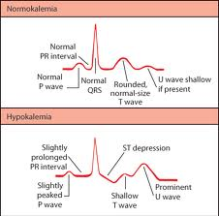
IBD Interventions
Fluid and electrolyte imbalances- huge risk of cardiac dysrhythmias secondary to K and Mg loss from severe diarrhea
Colonoscopy- long term inflammatory bowel disease increases risk of colon cancer, so regular colonoscopies every few years.
Surgical management in severe or uncontrolled cases and sometimes to let the bowel rest.

Slide 30
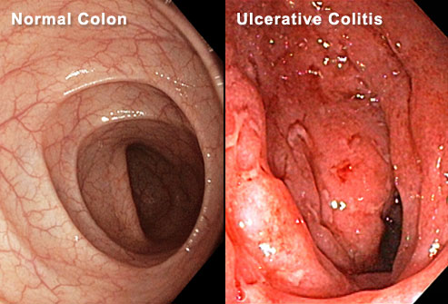
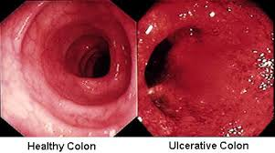
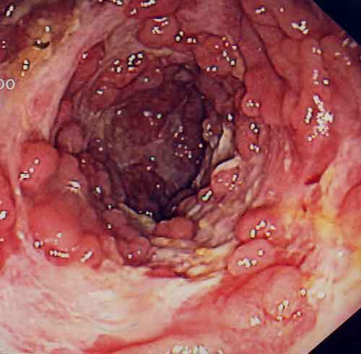
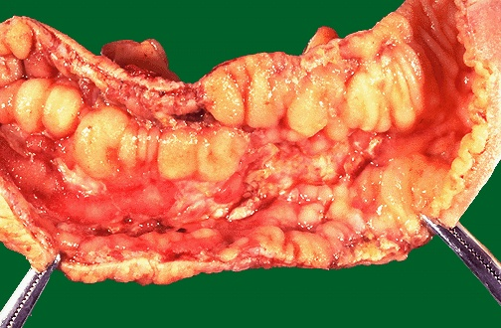
IBD

Slide 31
Q
The nurse is reviewing the record of a client with Crohn's disease. Which stool characteristic should the nurse expect to note documented in the client's record?
Diarrhea
Chronic Constipation
Constipation alternating with diarrhea
Stool constantly oozing from the rectum

Slide 32
A
A. Diarrhea
Crohn's disease is characterized by nonbloody diarrhea of usually not more than four to five stools daily. Over time, the diarrhea episodes increase in frequency, duration, and severity. Options 2, 3, and 4 are not characteristics of Crohn's disease.

Slide 33
Q
In performing a physical assessment of a client with a diagnosis of ulcerative colitis exacerbation, the nurse should expect which finding?
Hypercalcemia
Fibrous stricture
Frothy, fatty stools
Decreased hemoglobin

Slide 34
A
D. Decreased hemoglobin
Ulcerative colitis is an inflammatory disease of the large colon. The signs and symptoms of ulcerative colitis include diarrhea with up to 10 to 20 liquid bloody stools per day, weight loss, anorexia, fatigue, increased white blood cell count, increased erythrocyte sedimentation rate, dehydration, hyponatremia, and hypokalemia, not hypercalcemia. Because of the loss of blood, clients with ulcerative colitis commonly have decreased hemoglobin and hematocrit levels. Strictures and fistulas are more commonly seen in Crohn's disease than in ulcerative colitis. Clients with ulcerative colitis have bloody diarrhea, not steatorrhea (fatty, frothy, foul-smelling stools).

Slide 35
Q
The nurse is assisting a client with Crohn's disease to ambulate to the bathroom. After the client has a bowel movement, the nurse should assess the stool for which characteristic that is expected with this disease?
Blood in the stool
Chalky gray stool
Loose watery stool
Dry, hard, constipated stool

Slide 36
A
C. loose watery stool
Crohn's disease is characterized by nonbloody diarrhea of usually not more than four or five stools daily. Over time, the episodes of diarrhea increase in frequency, duration, and severity. Options 1, 2, and 4 are not characteristics of the stool in Crohn's disease.

Slide 37
Story Time
http://www.youtube.com/watch?v=7a2CzDZ_te4&feature=related

Slide 38
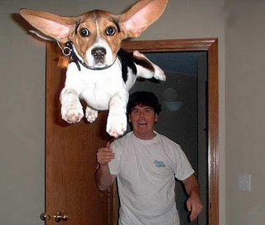
Actor #6

Slide 39
Intestinal obstruction
Mechanical- Detectable occlusions such as with adhesions, tumors, strictures
Nonmechanical- neuromuscular or vascular disorder such as with paralytic ileus.
Partial or complete
Signs and symptoms- abdominal pain and distention, nausea, and vomiting. If left untreated, intestinal obstruction can cause the blocked parts of your intestine to die. This tissue death can lead to perforation of the intestine, severe infection and shock.
What are our priority assessments? What nursing priorities will guide your plan of care?

Slide 40
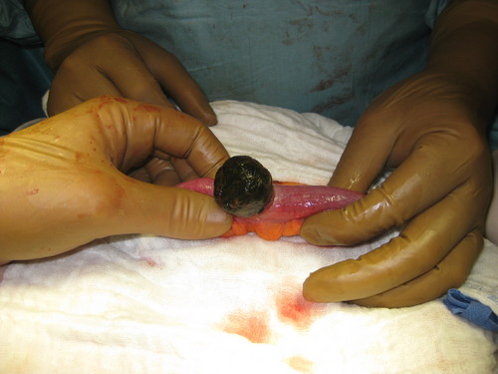
Intestinal obstruction
Small bowel obstructions can lead to severe fluid and electrolyte imbalances.
Assess for abdominal distention, especially on high risk patients, as this could indicate an obstruction.
Change in the nature of pain in obstruction could signal peritonitis or perforation so nurse should immediately check for rebound tenderness and bowel sounds.

Slide 41
Obstruction
All patients with suspected intestinal obstruction are hospitalized. Treatment must be rapid, because strangulating obstructions can be fatal. Treatment may consist of inserting NG tube to suction out the contents of the stomach and intestines. The patient is then given intravenous fluids to prevent dehydration and correct electrolyte imbalances.
Nursing considerations: I/O, abdominal girth measurements, Fluid and electrolytes, emesis (frequency, odor), pain management

Slide 42
Obstruction
If other efforts fail, surgery is necessary. Strangulated obstructions require emergency surgery. The obstructed area is removed and part of the bowel is cut away. If the obstruction is caused by tumors, polyps, or scar tissue, they are removed. Antibiotics are given to reduce the possibility of infection.
Labs
Increase WBC could indicate perforation or strangulation
Increase in Hct could indicate hemoconcentration
Decrease in H/H could indicate bleeding
Electrolytes, BUN, Cr help assess dehydration
Metabolic alkalosis from vomiting
Diagnostics: CT, abd x-ray

Slide 43
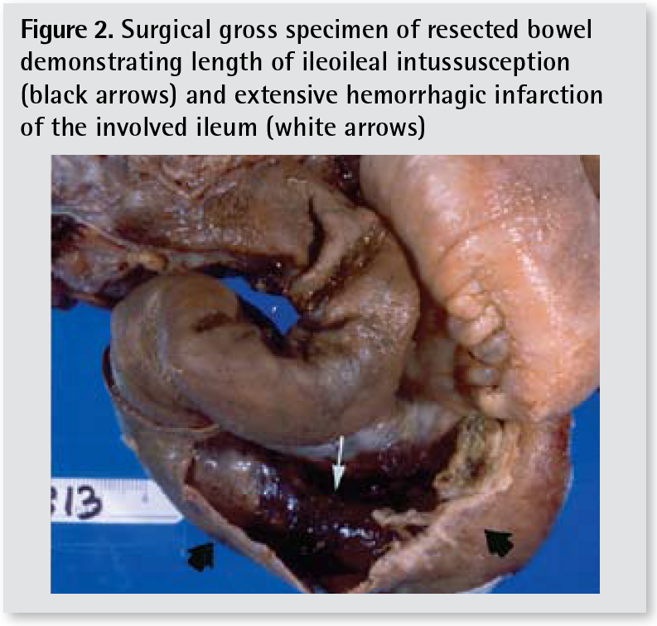
Obstruction

Slide 44
Actor #7

Slide 45
Peritonitis
Inflammatory process of peritoneum- get infection treated
Peritoneum normally a sterile area
Primary- infection via bloodstream, more rare than secondary
Ex- ascites from cirrhosis of liver provides great environment for bacterial to flourish
Secondary- abd organs perforate or rupture (ruptured appy) and spill contents into peritoneum.
Abdominal pain most common symptom, what are some other clinical manifestations?
What other complications can peritonitis lead to?
What nursing interventions will you initiate?

Slide 46
Peritonitis
Clinical manifestations
Rigid board like abd, distention, NV, no flatus/stool, diminishing bowel sounds, rebound tenderness, fever, tachy, can cause respiratory complications
Interventions
IV fluids, abx, weight, I & O, NG, NPO, possibly oxygen, pain control
Surgery- identify and repair cause of peritonitis, control contamination, remove any foreign material, drain fluid
After surgery what are you monitoring for?

Slide 47
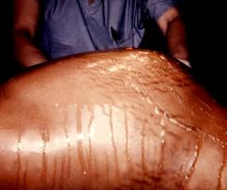
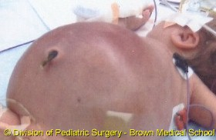
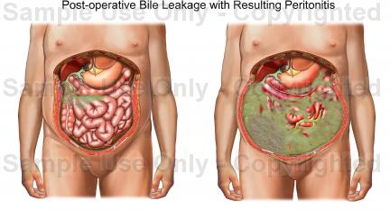
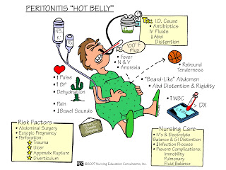
Peritonitis

Slide 48
Actor #8

Slide 49
Colorectal Cancer
3rd most common form of cancer
Insidious onset- symptoms not appearing until advanced
Risk factors include age, history, polyps, IBD, lifestyle
Rectal bleeding, anemia, and change is stool consistency or shape most common manifestation
Advocate regular screenings- Healthy People 2020 goal promoting evidence-based screening for cervical, colorectal, and breast cancer. Objectives also highlight the importance of monitoring the incidence of invasive cancer (cervical and colorectal) and late-stage breast cancer, which are intermediate markers of cancer screening success.
Screenings 50 years and average risk
Surgical therapy, worry is about metastasizing

Slide 50
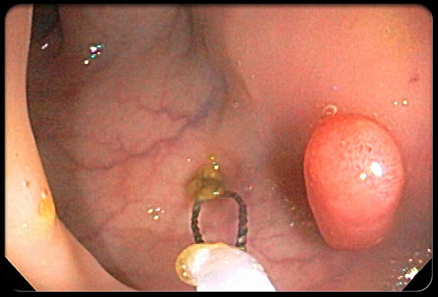
Colorectal Cancer

Slide 51
Actor #9

Slide 52
Diverticulitis
Diverticula-pouchlike herniations in wall of intestine
Diverticulosis-MANY pouchlike herniations
Diverticulitis-inflammation of the diverticula
CT scans allows for visualization of inflamed/infected pouches and rule out other conditions that mimic diverticulitis, such as irritable bowel syndrome. XR, Upper GI, Barium enema (not in acute phase)
What labs, VS, and assessments will you address?
What nursing priorities will guide your plan of care?
What nursing interventions will you initiate?

Slide 53
Diverticulitis
Check WBC, H/H, occult blood
NPO for severe symptoms
Dietary as appropriate- high fiber after acute phase
Medications antibiotics and pain meds as needed
No laxatives during acute phase as this increase pressure pressure in bowel, causing more outpouching of the lumen.
Severe cases or recurrent attacks of diverticulitis or at risk of complications from the condition, may need surgery to remove the diseased portion of colon.
Acute pain to LLQ- main symptom
Table 43-30 p 995 nice outline of care

Slide 54
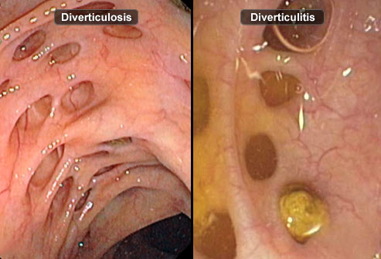
Diverticulitis

Slide 55
Q
A client is admitted to the hospital with a diagnosis of acute diverticulitis. What should the nurse expect to be prescribed for this client?
NPO (nothing by mouth) status
Ambulation at least four times daily
Cholinergic medications to reduce pain
Coughing and deep breathing every 2 hours

Slide 56
A
A NPO (nothing by mouth) status
During the acute phase of diverticulitis, the goal of treatment is to rest the bowel and allow the inflammation to subside. The client remains NPO and is placed on bed rest. Pain occurs from bowel spasms, and increased intra-abdominal pressure (coughing and deep breathing) may precipitate an attack. Ambulation and cholinergic will increase peristalsis. The remaining options are not interventions for the client with acute diverticulitis.

Slide 57
Actor #10

Slide 58
Food Poisoning
Salmonella=dehydration r/t diarrhea so fluid balance is a priority!! Transmitted by “five Fs”
Take all medications as ordered, carriers up to a year.
Botulism- paralytic disease, home canned foods. Risk for respiratory failure so watch!
Tx is botulism antitoxin, no honey in infants <12 months as spores have been found in honey. These bacteria are typically harmless to older kids and adults because their mature digestive systems can move the spores through the body before they cause any harm, but not infants quite ye.
Staphylococcus aureus- meat and dairy, unrefrigerated over period of time. Sudden onset of vomiting, abd cramping, and diarrhea within 2-4 hours.
Usually just fluids
E. coli- severe cramping, vomiting, may have bloody diarrhea
IV fluids, abx not effective
Wash hands, use different cutting boards for meat and veggies

Slide 59
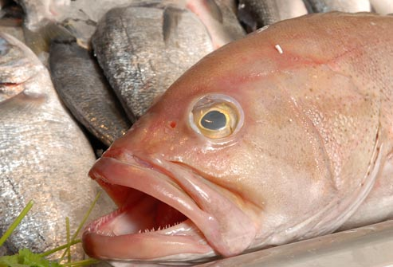
Food Poisoning

Slide 60
Actor #11

Slide 61
Gastroenteritis
Intestinal infection marked by watery diarrhea, abdominal cramps, nausea or vomiting, and sometimes fever.
Often called stomach flu — is through contact with an infected person or ingestion of contaminated food or water. If otherwise healthy, usually recover without complications. But for infants, older adults and people with compromised immune systems it can be deadly.
What changes in labs and VS will you trend?
What assessments will be relevant?
What nursing priorities will guide your plan of care?
What nursing interventions will you initiate?

Slide 62
Gastroenteritis
Diet- encourage fluids to prevent dehydration, may need IV hydration depending upon severity, orthostatic VS
Drugs that suppress motility should not be given, abx if bacterial
Good skin care

Slide 63
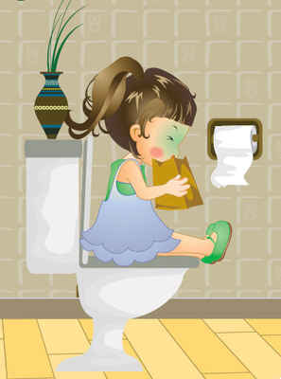
Gastroenteritis

Slide 64
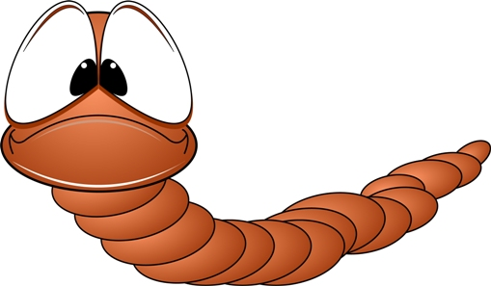
Commercial Break
http://www.youtube.com/watch?v=6M_bBOSV67Y&feature=related
http://www.youtube.com/watch?v=HOaZCkA8Zvk&feature=related

Slide 65
Actor #12

Slide 66
Lower GI Bleed
Upper- can be from PUD, CA, esophageal varices
Bright red- arterial source and profuse, has not come into contact with gastric acid
Coffee ground-blood in stomach for awhile
Melena- black, tarry stools, slow upper GI bleed, longer passage of blood through intestines the darker the stool related to breakdown of Hbg and release of iron
Lower- depending on location of bleed can be bright red, melena (black tarry), or maroon. Can be slow trickle to massive hemorrhage. If an upper bleed is massive and brisk could present with bright red blood per rectum. Colonoscopy.
Caused by variety of issues such as inflammatory condition, cancer, diverticulosis, infection (salmonella)

Slide 67
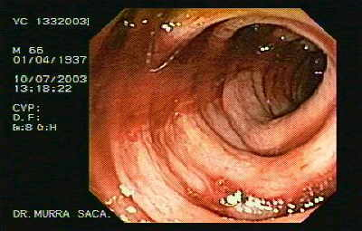
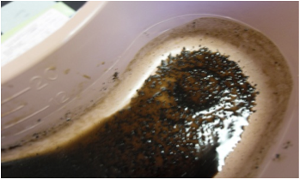
Nursing Management
What labs will you monitor for? What nursing assessments will be your priority and why? What interventions will initiate ?

Slide 68
Lower GI Bleed
Monitor CBC, coag studies, and electrolytes. Monitor hemodynamic status, cardiovascular assessment, neurological assessment
Initially IV fluid resuscitation with large bore IV access and what fluid? The blood loss and hemodynamic status determined.
Various tx depending on problem/cause including surgery, epi injection at site (via colonoscopy). Worst case vasoconstrictive agents if unknown where bleed is and unstable.

Slide 69
GI bleed

Slide 70
Q
A client presents to the emergency department with upper gastrointestinal bleeding and is in moderate distress. In planning care, what is the priority nursing action for this client?
Assessment of vital signs
Completion of abdominal examination
Insertion of the prescribed nasogastric tube
Thorough investigation of precipitating events

Slide 71
A
A. VS
The priority nursing action is to assess the vital signs. This would indicate the amount of blood loss that has occurred and provide a baseline by which to monitor the progress of treatment. The client may be unable to provide subjective data until the immediate physical needs are met. Although an abdominal examination and an assessment of the precipitating events may be necessary, these actions are not the priority. Insertion of a nasogastric tube is not the priority; in addition, the vital signs should be checked before performing this procedure.

Slide 72
Overall GI assessment
This includes what? What labs are important? What are patient priorities? How can the GI system affect other systems?

Slide 73
Are You Stressed?
Study done at GBC. The picture shows 2 dolphins.
Those who were experiencing stress saw a difference between the two dolphins.
Those who were NOT experiencing stress saw no difference between the two dolphins.
Use this as a guide during each semester to determine if YOU are stressed.

