Slide 1
Hepatitis - Inflammation of the Liver
*Caused by drugs, herbs, alcohol, chemicals, autoimmune diseases, metabolic abnormalities, Viruses (Viral Hepatitis – A, B, C, D, E)
Liver becomes enlarged and congested with inflammatory cells, lymphocytes, and fluid = RUQ pain
Liver’s normal lobular pattern becomes distorted as a result of widespread inflammation, necrosis, and hepatocellular regeneration.
Liver’s normal lobular pattern becomes distorted as a result of widespread inflammation, necrosis, and hepatocellular regeneration interfering with the blood flow into the hepatic lobules. Edema of liver’s bile channels results in obstructive jaundice.

Slide 2
Viral Hepatitis
Most common cause of hepatitis
A, B, C, D, E
Vary in Mode of Transmission/ Prevention (as well as onset and duration period)
**Lewis Table 44-1 p. 1007
Name the Type of Hepatitis:

Slide 3
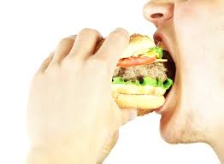
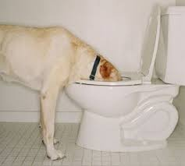
Hepatitis A & E
Transmitted by Fecal-Oral route by person to person contact or by consuming contaminated food or water
*Wash hands!! Before eating and after going to bathroom. Maintain sanitary conditions

Slide 4
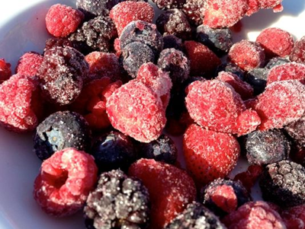
Hepatitis A
*Drink water treated by purification system
Do not consume shellfish caught in contaminated water

Slide 5
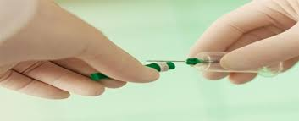
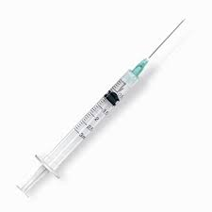
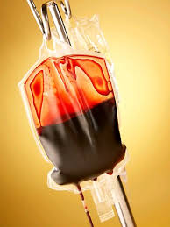
Hepatitis B & C Hepatitis D – Causes infection only when HBV is present
Do not share needles for injection, body piercing, or tattoos
Do not share razors, nail clippers, toothbrushes, or waterpiks
One syringe, one needle, one time
Do not recap needles! Activate safety device correctly!
*Exposure risk for those that received a blood transfusion in the U.S. before 1992

Slide 6
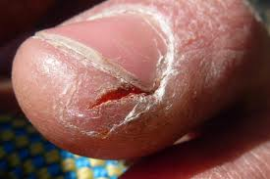
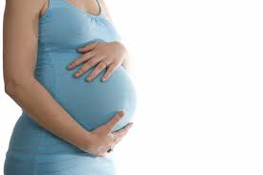
Hepatitis B
Cover cuts and sores with bandages

Slide 7
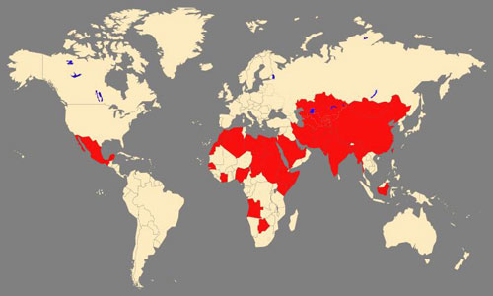
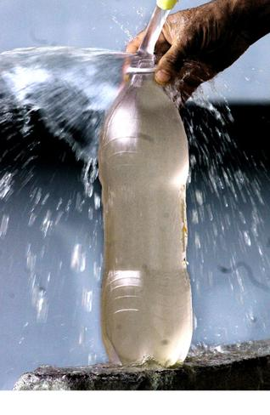
Hepatitis E
If traveling to non-industrialized countries drink only bottled water.
Avoid food washed or prepared with tap water, such as raw vegetables, fruits, and soups.

Slide 8
Hepatitis B & C
Sexual Intercourse with multiple Partners
Use a condom during sexual intercourse or abstain from this activity
Discuss risks with patients who have multiple partners

Slide 9
Hepatitis A & B
Prevention through Vaccination
Who should receive a Hepatitis A vaccine?
Who should receive a Hepatitis B vaccine?

Slide 10
Viral Hepatitis Facts:

Slide 11
What signs/ symptoms?
Flu like symptoms (HAV)
Anorexia, nausea, and vomiting
Diarrhea or constipation
Low grade-fever
Fatigue
RUQ pain
Pruritis
Headache
Dark urine with light colored stool
Lethargy, Malaise, fatigue
Weight loss
Joint Pain
Jaundice (changes in skin color or sclera)
Hepatomegaly
Splenomegaly

Slide 12
Nursing Considerations:
Labs: ALT, AST , serum bilirubin, PT/INR
Treatment:
Drugs used sparingly to rest liver.
HBV and HBC antiviral drugs used
Teach patient to avoid all medications including OTC drugs (esp. Tylenol) unless prescribed by MD

Slide 13
Nursing Considerations:
Psychosocial:
Social stigma associated with hepatitis, guilt about past actions, family members afraid of spreading virus/ getting infected, vague symptoms, depression
Activity:
Rest (Periods of rest alternating with periods of activity). Gradually add ADLs and ambulation as tolerated to activity
Diet:
Well balanced diet with high carbohydrates and calories with moderate amounts of fat and protein. Vitamin Supplements. Small frequent meals. No alcohol.

Slide 14
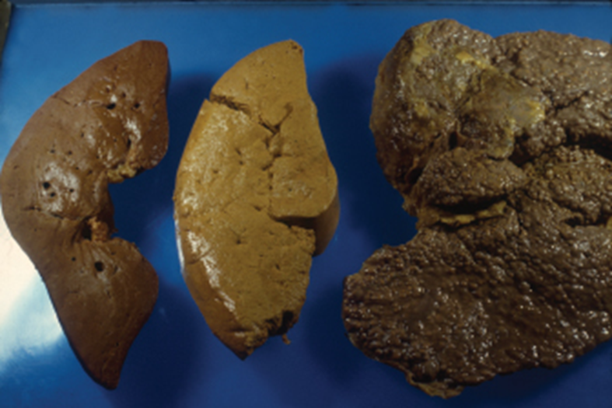
A healthy adult liver (left) weighs about 3 pounds. A liver damaged by alcoholism shows a buildup of fatty tissue (middle). A liver with cirrhosis is enlarged and swollen (right).
Glauberman/Photo Researchers, Inc.

Slide 15
Steatosis – “Fatty Liver”
Accumulation of fats in and around the hepatic cells
Causes:
Alcohol abuse
Nonalcoholic fatty liver disease
Diabetes
Obesity
Elevated lipids
Treatment:
Removing underlying cause
Weight loss, glucose control, and aggressive treatment through lipid lowering agents

Slide 16
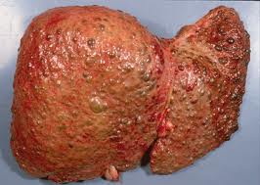
Cirrhosis
Most common causes: Chronic Hepatitis C Infection and alcohol-induced liver disease
Widespread fibrotic bands of connective tissue that change the liver’s normal function.
Inflammation = degeneration and destruction of hepatocytes
Hepatocytes attempt to regenerate, but the regenerative process is disorganized

Slide 17
What clinical manifestations may you see?
Jaundice
Light/ clay colored stools
Hepatomegaly
Skin Lesions
Hematologic problems (Anemia)
Ascites
Esophageal Varices
Anorexia
Fector hepaticus
Asterixis
Fatigue
Hepatorenal syndrome
Hepatic encephalopathy
Biliary obstruction
* Risk for spontaneous bacterial peritonitis

Slide 18
Nutritional Therapy
High carbs, moderate to low levels of fat, moderate protein (Except in patients with recurrent hepatic encephalopathy)
3000 calories/day for patients without complications
Alcohol cessation
Malnutrition common and serious concern in alcoholic cirrhosis (need for protein)
Decreased sodium (1-2 g)

Slide 19
Nutritional Therapy
Supplements (Ensure, Boost, multivitamins)
Avoid excessive vitamins that may be toxic to the liver (fat-soluble vitamins, niacin, iron supplements)
No Tylenol, No NSAIDS
Oral hygiene/ care before meals may improve taste sensation

Slide 20
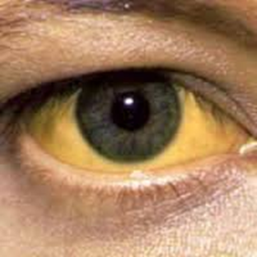
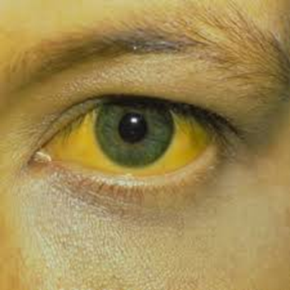
Jaundice

Slide 21
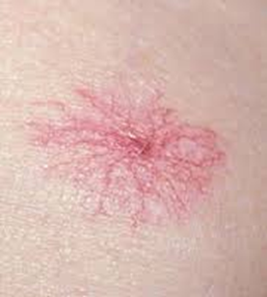
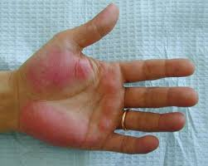
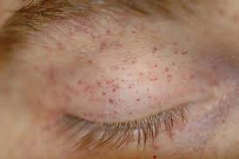
Skin Lesions Pruritis
Spider Angiomas – on the nose, cheeks, upper trunk, neck, and shoulders, Palmer erythema, Petechiae
*Attributed to an increase in circulating estrogen as a result of damaged liver’s inability to metabolize steroids
Itching of skin – secondary to collection of bile salts
Dry skin

Slide 22
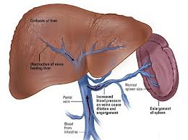
Portal Hypertension
Structural changes in liver = compression and destruction of the portal and hepatic veins causing obstruction to the normal flow of blood through the portal system
Persistent increase pressure > 5mmHG - blood flow backs into the spleen causing splenomegaly.
Veins in esophagus, stomach, intestine, and rectum become dilated
Non selective Beta-Blockers (propranolol) reduce portal hypertension

Slide 23
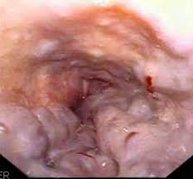
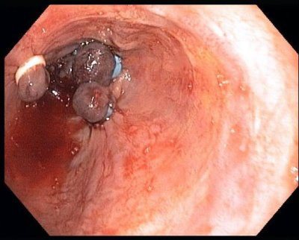
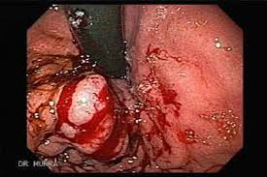
Esophageal Varices
Collateral circulation and dilation of veins
*Bleeding risk

Slide 24
What are some nursing considerations for patients with esophageal varices?
Prevention of bleeding and hemorrhage
EGD screening
Bleeding = sclerotherapy, banding (endoscopic variceal ligation), balloon tamponade
Patient with bleeding varicies
*Maintain Airway
Administration of IV terlipressin (synthetic vasopressin) octreotide or vasopressin to stop bleeding
Administration of PRBCs, FFP, albumin, platelets
Teaching – avoid alcohol and NSAIDS
Labs – H/H, INR, PTT

Slide 25
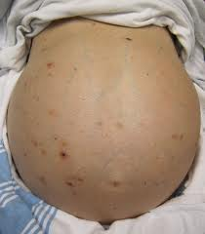
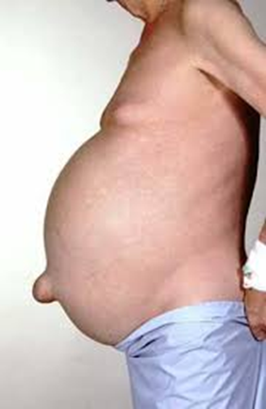
Ascites
Accumulation of fluid in the peritoneal cavity
Fluid shifts from the vascular system into the abdomen “third spacing”
Massive ascites = renal vasoconstriction and activation of the renin-angiotensin system resulting in sodium and water retention which leads to more ascites

Slide 26
Management of Ascites
Nutrition – Sodium restriction
Monitor – abdominal girth, daily weights, I’s & O’s
Diuretics – Combination therapy
Potassium sparing – spironolactone (aldactone)
Loop diuretic – furosemide (Lasix)
Albumin infusion - help maintain intravascular volume and adequate urine output by increasing plasma colloid osmotic pressure

Slide 27
Paracentesis (needle puncture in abdominal cavity) – remove ascetic fluid (or test for spontaneous peritonitis)
Used for patients with impaired respiration or abdominal pain caused by severe ascites
Have patient void immediately before to avoid puncture to the bladder
After monitor for hypovolemia and electrolyte imbalances, observe dressing for leaking/ bleeding
Transjugular intrahepatic portosystemic shunt (TIPS)

Slide 28
Hepatic Encephalopathy
https://www.youtube.com/watch?v=MP-Q6fwhFWE
https://www.youtube.com/watch?v=NQBXlrb8Xmk
Asterixis “Liver flap” – flapping tremors, when patient is asked to hold their arms and hands stretched out, the patient is unable to hold this position and performs a series of rapid flexion and extension movements.
Peripheral neuropathy
Management:
Reduction of ammonia formation (In intestines)
- Lactulose
- Antibiotics (Rifaximin)
- Restrict protein for acute flare ups. (Otherwise cirrhosis patients need overall good nutrition, including protein)

Slide 29
What lab findings are pertinent with Cirrhosis/ what might you expect to find?
LABS:
↑ AST & ↑ ALT
↑LDH, ↑ bilirubin
↑ (prolonged) PT/INR (due to liver decreases in production of prothrombin)
↓ platelets (thrombocytopenia)
↓ H/H
↑ ammonia (advanced liver disease)
↓ albumin
↑ serum creatinine (in patients with deteriorating kidney function associated with liver disease)
Dilutional hyponatremia may occur in patients with ascites

