Slide 1
Human Immunodeficiency Virus (HIV) Infection
Chapter 15

Slide 2
Human Immunodeficiency Virus Infection
Globally
33 million living with HIV
2.7 million new infections each year
2 million HIV-related deaths each year
Retrovirus that causes immunosuppression making persons susceptible to infections
Notes:
Human immunodeficiency virus (HIV) infection is a global pandemic affecting millions.
HIV is a retrovirus that causes immunosuppression. The viral infection causes the person to be susceptible to infections that would normally be controlled through immune responses.
The term HIV disease is used interchangeably with HIV infection.
Since the beginning of the epidemic, sub-Saharan Africa has been the most devastated, but the Caribbean, Asia, Eastern Europe, and South America also have growing epidemics.

Slide 3
Significance of Problem
Advances in prevention, testing, and treatment have resulted in longer life-spans and lower death rates.
In the United States
56,000 new infections each year
Highly associated with lifestyles disenfranchised by much of society
Notes:
In the past 30 years, important advances have been made in HIV prevention, testing, and treatment.
With advances in treatment, HIV is managed as a chronic disease as people are living longer, resulting in a dramatic drop in the death rate attributable to HIV.
In developed countries, the result has been decreases in the number of HIV-related deaths, improved quality of life, and a significant decrease in the number of children born with HIV.
More than 1 million people are currently living with HIV in the United States, with an estimated 56,000-60,000 new infections occurring annually.
In North America the prevalence of HIV has been highest among men who have sex with men, but women, people of color, people who live in poverty, and adolescents contribute an expanding proportion of new HIV infections.
For the most part, HIV remains a disease of marginalized individuals: those who are disenfranchised by virtue of gender, race, sexual orientation, poverty, drug use, or lack of access to health care.

Slide 4
Case Study
iStockphoto/Thinkstock
A.O. is a 20-year old Hispanic male college student who comes to the student health center complaining of pain on urination.
His urine test is positive for Neisseria gonorrhea.
What should you do?
Notes:
Talk about treatment options for the gonorrhea.
Obtain a complete health and social history including drug and sexual practices.

Slide 5
Transmission of HIV
Fragile virus transmitted only through contact with body fluids under specific conditions
Blood, semen, vaginal secretions, and breast milk
Sexual contact with an infected partner is the most common mode of transmission.
Notes:
HIV can only be transmitted under specific conditions that allow contact with infected body fluids, including blood, semen, vaginal secretions, and breast milk.
In developing countries, the major route of transmission is heterosexual sex, and women and children bear a large part of the burden of illness.
The most common mode of HIV transmission is unprotected sexual contact with an HIV-infected partner.
Sexual activity involves contact with semen, vaginal secretions, and/or blood, all of which have lymphocytes that may contain HIV.
During any form of sexual intercourse (anal, vaginal, or oral), the risk of infection is greater for the partner who receives the semen, although infection can also be transmitted to the inserting partner. This occurs because the receiver has prolonged contact with infected fluids and helps explain why it is easier to infect women than men during heterosexual intercourse.
Sexual activities that cause trauma to local tissues can increase the risk of transmission.
In addition, the presence of genital lesions from other sexually transmitted diseases (e.g., herpes, syphilis) significantly increases the likelihood of transmission.

Slide 6
Transmission of HIV
Contact with blood and blood products
Sharing drug-using equipment is risky.
Infection through transfusions of blood or clotting factors is now unlikely with implementation of screening measures.
Puncture wounds are most common means of work-related HIV transmission.
Notes:
HIV can be transmitted during exposure to blood through drug-using equipment. Used equipment may be contaminated with HIV and other blood-borne organisms, and sharing that equipment can result in disease transmission.
In North America, transfusion of infected blood and blood products has caused only 1% of adult AIDS cases.
Routine screening of blood donors to identify at-risk individuals and testing donated blood for the presence of HIV have improved the safety of the blood supply.
The risk of infection after a needle-stick exposure to HIV-infected blood is 0.3% to 0.4% (or 3 to 4 out of 1000). The risk is higher if the exposure involves blood from a patient with a high level of circulating HIV, a deep puncture wound, a needle with a hollow bore and visible blood, a device used for venous or arterial access, or a patient who dies within 60 days.
Splash exposures of blood on skin with an open lesion present some risk, but it is much lower than from a puncture wound.
Health care workers have a low risk of acquiring HIV at work, even after a needle-stick injury.

Slide 7
Transmission of HIV
Perinatal transmission
Can occur during pregnancy, delivery, or breastfeeding
An average of 25% of infants born to women with untreated HIV will contract the infection.
Treatment can reduce the rate of transmission to less than 2%.
Notes:
Perinatal transmission can occur from an HIV-infected mother to her infant.
Fortunately, the risk of transmission can be reduced to less than 2% in settings where pregnant women are routinely tested for HIV infection and, if found to be infected, treated with antiretroviral therapy (ART).

Slide 8
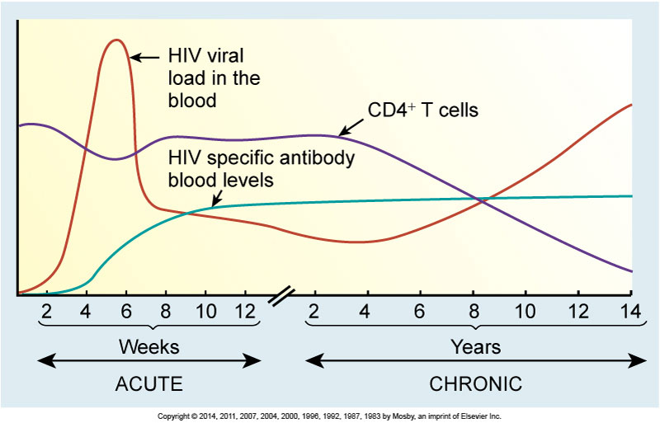
Viral Load in Blood and CD4+ T-Cell Counts
Notes:
HIV-infected individuals can transmit HIV to others within a few days after becoming infected.
Transmission of HIV is subject to the same requirements as other microorganisms (i.e., a large enough amount of the virus must enter the body of a susceptible host).
Variables that influence whether infection will be established after an exposure include (1) duration and frequency of contact with the organism; (2) volume, virulence, and concentration of the organism; and (3) host immune status.

Slide 9
Notes:
Initial infection with HIV results in viremia (large amounts of virus in the blood).
The concentration of virus is an important variable. Large amounts of HIV can be found in the blood and, to a lesser extent, in the semen during the first 6 months of infection and again during the late stages of the disease.
Although unprotected sexual intercourse or blood exposure to an infected individual during these periods is more risky, HIV can be transmitted during all phases of the disease.

Slide 10
Transmission of HIV
Modes of transmission
HIV is not spread through casual contact:
Not hugging
Not dry kissing
Not shaking hands
Not sharing eating utensils
Not using toilet seats
Notes:
It is not spread by tears, saliva, urine, emesis, sputum, feces, sweat, respiratory droplets, or enteric routes.

Slide 11
Case Study
iStockphoto/Thinkstock
A.O. informs you he has been sexually active since age 15 with both males and females.
He states he is always “on top” (inserting partner).

Slide 12
Case Study
iStockphoto/Thinkstock
He has had intercourse with 3 people in the last month and doesn’t use protection.
What should you do next?
Notes:
If you haven’t already recommended it, further testing for other STIs including HIV is in order.
Inform him that testing is the only way to determine if he has contracted HIV.
Negative results can relieve anxieties about past behaviors and provide opportunities for prevention teaching.
Positive results can provide impetus to seek treatment and protect his sex partners.
Talk with him about ways to protect himself and others from sexually transmitted diseases:
Abstinence
Non-contact sex
Use of barriers

Slide 13
Pathophysiology of HIV
HIV is a ribonucleic acid virus.
Called retroviruses because they replicate in a “backward” manner going from RNA to DNA
RNA virus that was discovered in 1983
Binds to specific CD4 and chemokine receptors to enter cell
Notes:
HIV uses the chemokine receptors CXCR4 and CCR5 as co-receptors (CD4 is the main receptor) to support binding and entry into the CD4⁺ T cell.
HIV is a ribonucleic acid (RNA) virus, which replicates by using its RNA as a template to produce deoxyribonucleic acid (DNA), which is then integrated into the human genome.
Immune dysfunction in HIV infection is caused by damage and destruction of CD4⁺ T cells (also known as T helper cells or CD4⁺ T lymphocytes).

Slide 14
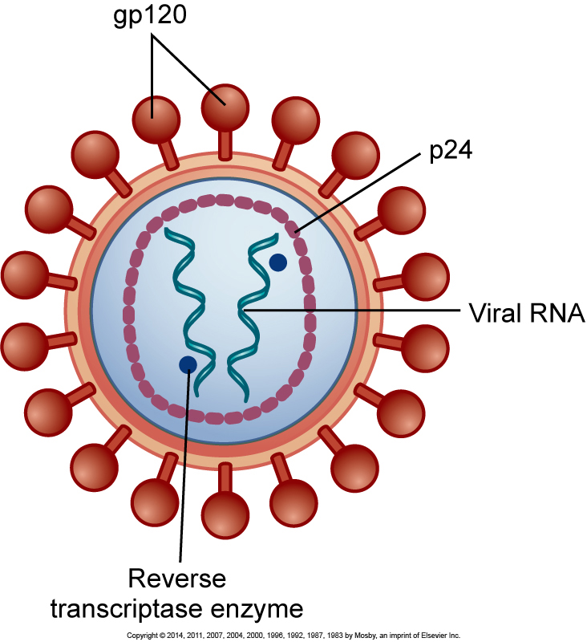
Components of HIV
Notes:
Like all viruses, HIV cannot replicate unless it is inside a living cell.
HIV is surrounded by an envelope made up of proteins (including gp120) and contains a core of viral RNA and proteins.

Slide 15
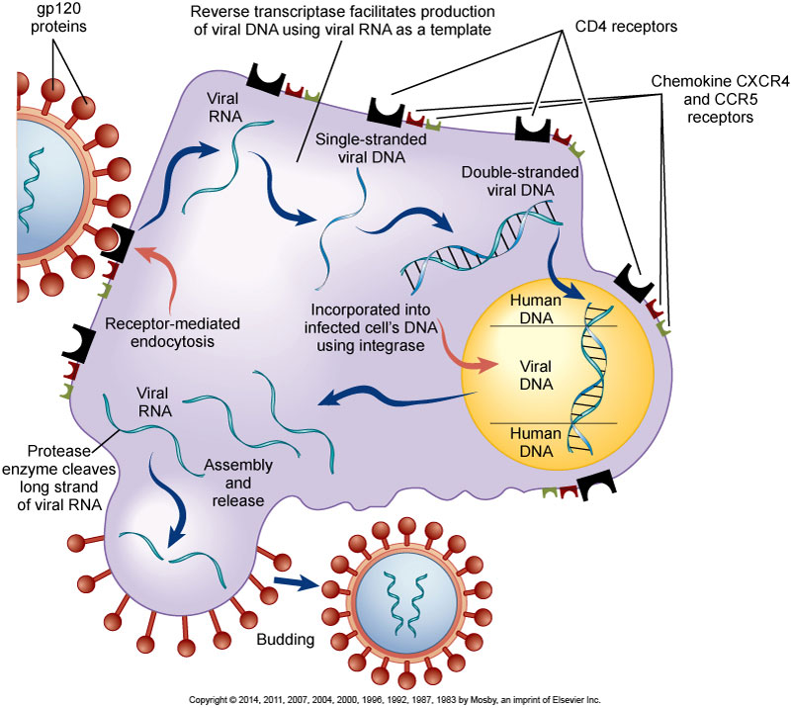
HIV Proteins Bind to Cell
15
Notes:
HIV has gp120 glycoproteins that attach to CD4 and chemokine CXCR4 and CCR5 receptors on the surface of CD4⁺ T cells (fusion).
Viral RNA then enters the cell, produces viral DNA in the presence of reverse transcriptase, and incorporates itself into the human genome in the presence of integrase, causing permanent cellular infection and the production of new virions.
There are two consequences of this action: (1) because all genetic material is replicated during cell division, all daughter cells will also be infected, and (2) viral DNA in the genome will direct the cell to make new HIV.
New viral RNA develops initially in long strands that are cut in the presence of protease and leave the cell through a budding process that ultimately contributes to cellular destruction.

Slide 16
Viral Load in the Blood
Initial infection
Viremia (large viral levels in blood) for 2 to 3 weeks
Transmission is more likely when viral load is high.
Followed by prolonged period (years) of low viral load
Notes:
Initial infection with HIV that results in viremia lasts a few weeks.
During the time of low viral load, which may last for more than 10 years, clinical symptoms can be limited. Even without symptoms, HIV replication occurs at a rapid and constant rate in the blood and lymph tissues.
A major consequence of rapid replication is that errors can occur in the copying process, causing mutations that can contribute to resistance to ART and limit treatment options.

Slide 17
Pathophysiology of HIV
Cells with CD4 receptor sites are infected.
CD4+ T cells (T helper cells)
Lymphocytes
Monocytes/macrophages
Astrocytes
Oligodendrocytes
Notes:
In the initial stages of HIV infection, B cells and T cells respond and function normally.
B cells make HIV-specific antibodies that are effective in reducing viral loads in the blood.
Activated T cells mount a cellular immune response to viruses trapped in the lymph nodes.
Immune dysfunction in HIV disease is caused predominantly by damage to and destruction of CD4⁺ T cells (T helper cells or CD4+ T lymphocytes). These cells are targeted because they have more CD4 receptors on their surfaces than other CD4 receptor–bearing cells. CD4⁺ T cells play a key role in the immune system’s ability to recognize and defend against pathogens.
Adults without immune dysfunction normally have 800 to 1200 CD4⁺ T cells/microliter (μL) of blood. The normal life span of a CD4⁺ T cell is about 100 days, but HIV-infected CD4⁺ T cells will die after an average of only 2 days.
HIV destroys about 1 billion CD4⁺ T cells every day.
The body is able to produce new CD4⁺ T cells to replace the destroyed cells for many years. However, eventually the ability of HIV to destroy CD4⁺ T cells exceeds the body’s ability to replace the cells.

Slide 18
Pathophysiology of HIV
Immune problems start when CD4+ T-cell counts drop to < 500 cells/μL.
Severe problems develop when < 200 CD4+ T cells/μL.
Normal range is 800 to 1200 cells/μL.
Insufficient immune response allows for opportunistic diseases.
Notes:
Generally, the immune system will remain healthy with more than 500 CD4⁺ T cells/μL.
Severe problems begin to develop with fewer than 200 CD4⁺ T cells/μL.
With HIV, a point is eventually reached where so many CD4⁺ T cells have been destroyed that there are not enough left to regulate immune responses.
The major concern related to immune suppression is the development of opportunistic diseases (infections and cancers that occur in immunosuppressed patients that can lead to disability, disease, and death).

Slide 19
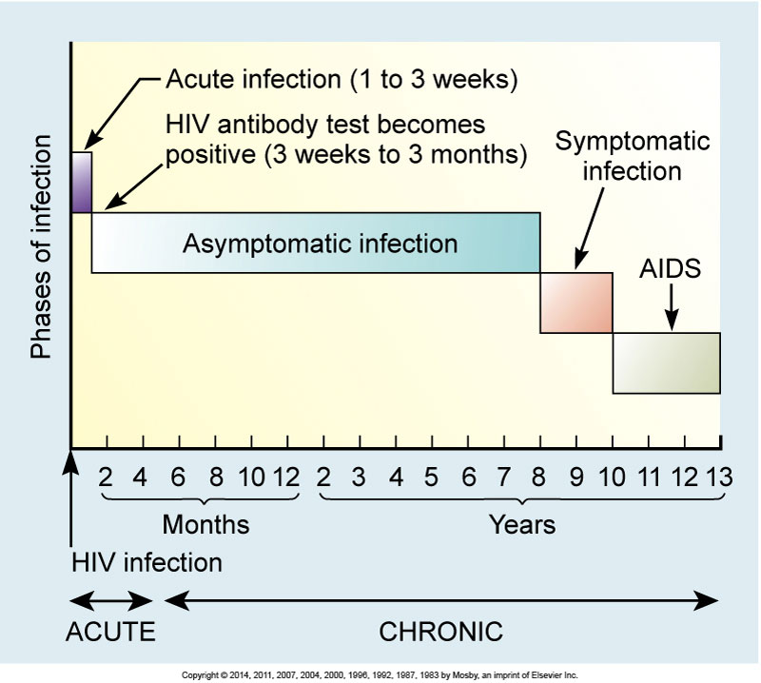
Timeline for Untreated HIV Infection
19
Notes:
This displays the typical course of untreated HIV infection.
It is important to remember that (1) disease progression is highly individualized, (2) treatment can significantly alter this pattern, and (3) an individual’s prognosis is unpredictable.
The information depicted in this figure represents data from large groups of people and should not be used to predict an individual’s prognosis.

Slide 20
Clinical Manifestations and Complications
Acute Infection
Flulike symptoms
Fever, swollen lymph glands, sore throat, headache, malaise, nausea, muscle and joint pain, diarrhea, or a diffuse rash accompanies seroconversion.
Occurs about 2 to 4 weeks after infection
Lasts for 1 to 2 weeks
Notes:
HIV infections are divided into different stages, including acute, asymptomatic, symptomatic, and AIDS.
In acute HIV infection seroconversion (when HIV-specific antibodies develop) is often accompanied by a mononucleosis-like syndrome that may be mistaken for the flu. These symptoms generally occur 2 to 4 weeks after the initial infection and last for 1 to 2 weeks, although some symptoms may persist for several months.
Some people also develop neurologic complications, such as aseptic meningitis, peripheral neuropathy, facial palsy, or Guillain-Barré syndrome.
During this time, a high viral load (the amount of HIV circulating in the blood) is noted, and CD4⁺ T cell counts fall temporarily but quickly return to baseline or near-baseline levels.
Many people, including health care providers, mistake acute HIV symptoms for a bad case of the flu.

Slide 21
Clinical Manifestations and Complications
Asymptomatic Infection
Median interval of 11 years between infection and diagnosis of AIDS
Fatigue, headache, low-grade fever, night sweats, PGL, and other symptoms
Most are not aware of infected status and thus continue usual activities which may include high-risk sexual or drug-using behaviors causing a serious public health problem.
Notes:
Asymptomatic infection is the interval between untreated HIV infection and a diagnosis of AIDS.
During this time, CD4⁺ T cell counts remain above 500 cells/μL (normal or only slightly decreased), and the viral load in the blood will be low.
Because people are often unaware of their disease status, they have little reason to seek treatment or make behavior changes that could improve the quality and length of their lives and can unknowingly transmit HIV to others.

Slide 22
Clinical Manifestations and Complications
Symptomatic Infection
CD4+ T cells drop to 200 to 500 cells/μL.
Viral load increases.
Symptoms seen in earlier phases become worse.
Other problems develop.
HIV advances to a more active state.
Notes:
Symptomatic infection occurs as the CD4⁺ T-cell count drops to 200 to 500 cells/μL and the viral load increases.
Symptoms seen in earlier phases become worse, leading to persistent fever, frequent drenching night sweats, chronic diarrhea, recurrent headaches, and fatigue severe enough to interrupt normal routines.
Other problems, including infections, lymphadenopathy, and nervous system manifestations, may occur.

Slide 23
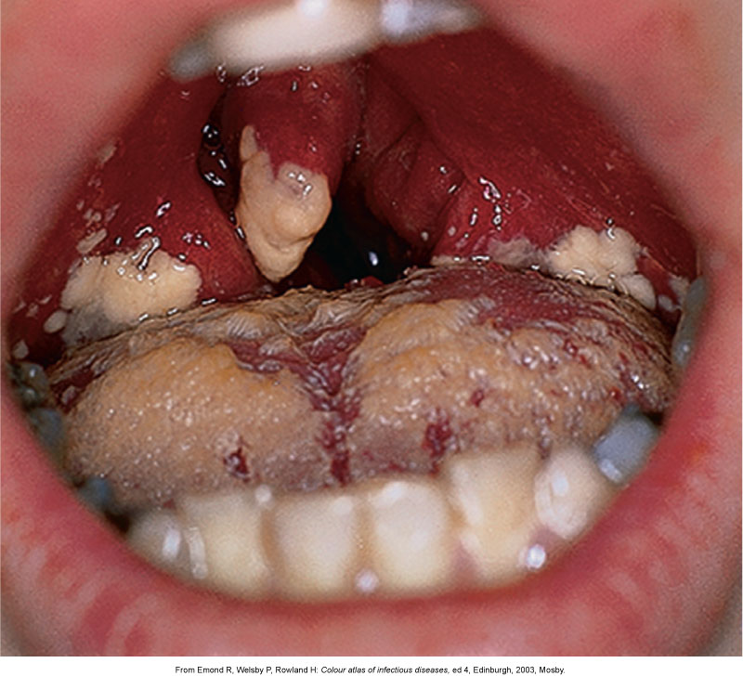
Oral Thrush
Notes:
The most common infection associated with the symptomatic infection phase of HIV infection is oropharyngeal candidiasis or thrush.
Candida rarely causes problems in healthy adults but is more common in HIV-infected people.

Slide 24
Clinical Manifestations and Complications
Symptomatic Infection
Shingles
Persistent vaginal candidal infections
Herpes
Bacterial infections
Notes:
Other infections that can occur at this time include shingles (caused by the varicella-zoster virus), persistent vaginal candidal infections, outbreaks of oral or genital herpes, and bacterial infections.

Slide 25
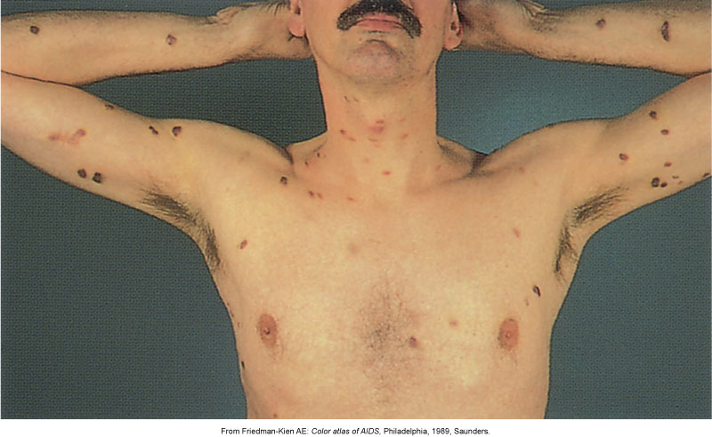
Kaposi Sarcoma
Notes:
Malignant vascular lesions such as KS lesions can appear anywhere on the skin surface or on internal organs.
Kaposi sarcoma is caused by human herpesvirus 8.
Lesions vary in size from pinpoint to very large and may appear in a variety of shades.

Slide 26
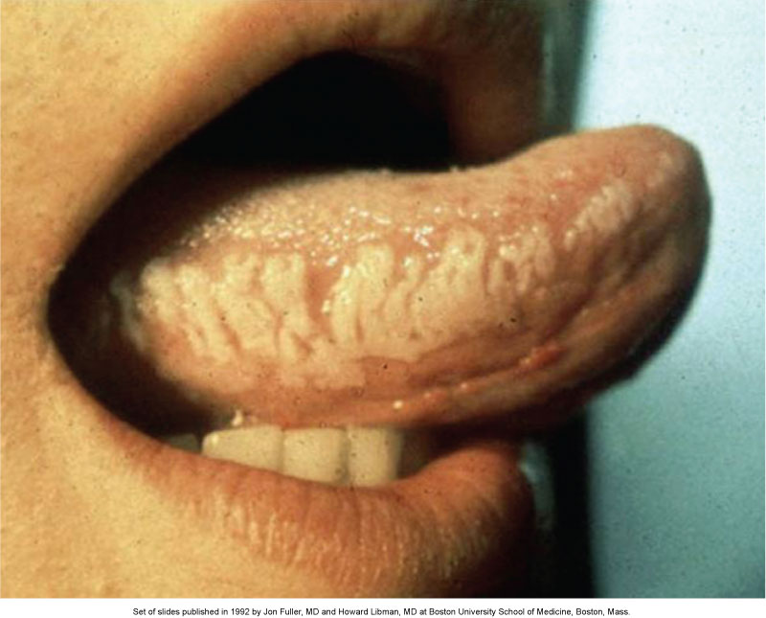
Oral Hairy Leukoplakia
Notes:
Oral hairy leukoplakia, an Epstein-Barr virus infection that causes painless, white, raised lesions on the lateral aspect of the tongue, can occur at this phase of the infection and is also an indicator of disease progression.

Slide 27
Clinical Manifestations and Complications
AIDS
Immune system severely compromised
Great risk for opportunistic disease
Possible malignancies, wasting, and dementia
Notes:
A diagnosis of AIDS cannot be made until the HIV-infected patient meets criteria established by the CDC.
AIDS is characterized by:
Severe immune system suppression and CD4⁺ T-cell counts < 200 cells/μL
An opportunistic infection
An opportunistic cancer
Wasting syndrome (loss of 10% or more of ideal body mass)
AIDS dementia complex (ADC).

Slide 28
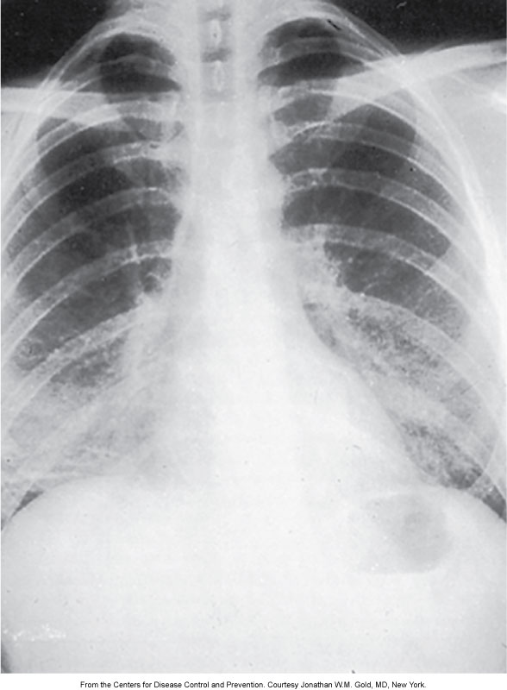
Pneumocystis jiroveci Pneumonia
28
Notes:
Opportunistic diseases generally do not occur in the presence of a functioning immune system.
Pneumocystis jiroveci is a type of pneumonia that can appear as an opportunistic disease associated with HIV infection.

Slide 29
Case Study
iStockphoto/Thinkstock
A.O. tells you he drinks at weekend parties and has smoked pot but “not recently.”
He reports no regular use of injection drugs, tobacco, or anabolic steroids but that sometimes he gets so drunk he doesn’t remember.
How would you rate his risk and why?
Notes:
A.O. is at high risk for contracting another STI and/or HIV because of his active sexual life with multiple partners, direct contact sex with same-sex partners, inability to recall possible exposure when under the influence, unprotected sex, and history of STI.

Slide 30
Clinical Manifestations and Complications
Common opportunistic diseases
Cryptococcal meningitis
Cytomegalovirus retinitis
Mycobacterium avium complex
Kaposi sarcoma
Influenza virus
Notes:
See Table 15-10.
Organisms that do not cause severe disease in people with functioning immune systems can cause debilitating, disseminated, and life-threatening infections during this stage.
Several opportunistic diseases may occur at the same time, further compounding the difficulties of diagnosis and treatment.
Advances in HIV treatment have decreased occurrences of opportunistic diseases.

Slide 31
Diagnostic Studies
Most useful screening tests detect HIV-specific antibodies.
May take several weeks to detect antibodies (window period)
Rapid HIV-antibody tests can provide results before patients leave the office but should be confirmed.
Beneficial as many do not return for follow-up
Notes:
Diagnosis of HIV infection is made by testing for HIV antibodies and/or antigen in the blood.
The most useful screening tests for HIV are those that detect HIV-specific antibodies. The major problem with these tests is that there is a median delay of 4 weeks after infection before antibodies can be detected. This creates a window period during which an infected individual may not test positive for HIV antibodies.
Rapid HIV-antibody tests provide results in 20 minutes and are recommended by the CDC.
Standard antibody tests done on blood or oral fluid specimens are tested by a laboratory and provide results from a day to a week later.
Rapid testing is highly reliable and provides immediate feedback to patients who can then be counseled about treatment and prevention. This is an important advantage because many people do not return to get their test results when other testing methods (take longer to obtain the results) are used.
Positive antibody tests should be confirmed by another test, usually the Western blot.
See Table 15-11 on HIV-antibody test screening process.

Slide 32
Diagnostic Studies
Progression monitored by CD4+ T-cell counts and viral load
CD4+ T-cell counts provide a marker of immune function and decrease as the disease progresses.
The lower the viral load the less active the disease.
Reported as real numbers or as undetectable
Notes:
The progression of HIV infection is monitored by two important laboratory assessments: CD4⁺ T-cell counts and HIV viral load.
CD4⁺ normal range is 800 to 1200 cells/μL.
In HIV, viral loads are reported as real numbers (i.e., 1260 copies/μL) or as undetectable.
“Undetectable” indicates the viral load is lower than the test is able to report; “undetectable” does not mean that the virus has been eliminated from the body or that the individual can no longer transmit HIV to others.

Slide 33
Diagnostic Studies
Abnormal blood tests are commonly caused by HIV, opportunistic diseases, or complications of therapy.
Decreased WBC counts
Altered liver function
Notes:
Abnormal blood test results are common in HIV infection and may be caused by HIV, opportunistic diseases, or complications of therapy.
Decreased white blood cell (WBC) counts, especially below-normal numbers of lymphocytes (lymphopenia) and neutrophils (neutropenia); low platelet counts (thrombocytopenia) and anemia are often seen.
Altered liver function, caused by HIV infection, drug therapy, or co-infection with a hepatitis virus, is common. Early identification of co-infection with hepatitis B virus (HBV) and/or hepatitis C virus (HCV) is extremely important because these infections have a more serious course in patients with HIV, may ultimately limit options for ART, and can cause liver-related morbidity and mortality.

Slide 34
Diagnostic Studies
Resistance tests can help determine new drug combinations for patients not responding to ART.
Genotype assay
Phenotype assay
Notes:
Two types of resistance tests can determine if a patient’s HIV is resistant to drugs used in ART: the genotype assay and the phenotype assay.
The genotype assay detects drug-resistant viral mutations that are present in reverse transcriptase and protease genes. The phenotype assay measures the growth of HIV in various concentrations of antiretroviral drugs (much like bacteria-antibiotic sensitivity tests). These assays help to determine new drug combinations for patients who are not responding to therapy.

Slide 35
Collaborative Care
Monitor disease progression, immune function, and manage symptoms.
Initiate and monitor ART.
Prevent and/or treat opportunistic infections.
Notes:
Collaborative care of the HIV-infected patient focuses on
(1) monitoring HIV disease progression and immune function
(2) initiating and monitoring antiretroviral therapy (ART)
(3) preventing the development of opportunistic diseases
(4) detecting and treating opportunistic diseases
(5) managing symptoms
(6) preventing or decreasing complications of treatment
(7) preventing further transmission of HIV.
To accomplish these objectives, ongoing assessment, clinician-patient interactions, and patient teaching and support are required.

Slide 36
Collaborative Care
Prevent or decrease complications of therapies.
Prevent further transmission.
Notes:
Collaborative care of the HIV-infected patient focuses on
(1) monitoring HIV disease progression and immune function
(2) initiating and monitoring antiretroviral therapy (ART)
(3) preventing the development of opportunistic diseases
(4) detecting and treating opportunistic diseases
(5) managing symptoms
(6) preventing or decreasing complications of treatment
(7) preventing further transmission of HIV.
To accomplish these objectives, ongoing assessment, clinician-patient interactions, and patient teaching and support are required.

Slide 37
Collaborative Care
Initial patient visit
Gather baseline data.
Begin to establish rapport and use patient input to develop a plan of care.
Initiate teaching about spectrum of HIV, treatment, preventing transmission, improving health, and family planning.
Notes:
Perform complete history and physical examination. These findings will determine the patient’s needs.
This is also a good time to ensure that case reports required by the state health department have been completed.
Determine the need for referrals.
Remember that a newly diagnosed patient may not be able to retain or understand information. Be prepared to repeat and clarify information over the course of several months.

Slide 38
Case Study
A.O. returns to the clinic 3 months later after refusing HIV testing or teaching.
He is now concerned as one of his “partners” was just diagnosed with HIV.
He wants help. What should you tell him about HIV testing?
iStockphoto/Thinkstock
Notes:
It involves testing a sample of blood or oral fluid for HIV-specific antibodies.
It is important you work together.
Testing is the only way to determine if he has HIV.
Early treatment and support is very important for his health.
You will provide him with information and support to help him understand and deal with this concern.
You would like to know more about his available support system.
You need to know when the last risk of exposure occurred.
Teaching is important to help prevent further STIs.
Tests need to be repeated at intervals for up to 3 months after each possible exposure.
Let him know if rapid testing is available at your clinic (staff is trained to perform the test and the clinic is qualified for a Clinical Laboratory Improvement Amendments (CLIA) waiver).
Results are available in 20 minutes, but it is more expensive than standard testing and should be verified with standard testing.
It is important to protect himself and his partners from further risky behaviors during the 3-month interval until final results are available.

Slide 39
Drug Therapy
Main goals
Decrease viral load.
Maintain/increase CD4+ counts.
Prevent HIV-related symptoms and opportunistic diseases.
Delay disease progression.
Notes:
Recommendations for starting therapy in the chronically infected patient are summarized in Table 15-12.
HIV cannot be cured, but ART can delay disease progression by decreasing viral replication. When taken consistently and correctly, ART can reduce viral loads by 90% to 99%, which makes adherence to treatment regimens extremely important.
The major advantage of using drugs from different classes is that combination therapy can inhibit viral replication in several different ways, making it more difficult for the virus to recover and decreasing the likelihood of drug resistance.
A major problem with most drugs used in ART is that resistance develops rapidly when they are used alone or taken in inadequate doses. Thus, combinations of three or more should be used.
Also, many ART drugs have dangerous and potentially lethal interactions with other commonly used drugs, including OTC and herbal therapies.

Slide 40
Drug Therapy
Opportunistic diseases complicate management of HIV infection.
Prevention is key.
Onset can be delayed with adequate measures.
Effective management has significantly increased life expectancy.
Notes:
Management of HIV is complicated by the many opportunistic diseases that can develop as the immune system deteriorates.
Examples of opportunistic diseases include Pneumocystis jiroveci pneumonia (PCP), Mycobacterium avium complex (MAC), and Kaposi sarcoma.
Prevention is the preferred approach to opportunistic diseases.
Adequate ART, vaccines (hepatitis B, influenza, pneumococcal), and disease-specific prevention measures can be effective in delaying or preventing many opportunistic diseases associated with HIV.
Although usually not possible to eradicate opportunistic diseases once they occur, prophylactic medications can significantly decrease morbidity and mortality rates.
Advances in prevention, diagnosis, and treatment of opportunistic diseases have contributed significantly to increased life expectancy.
See eTable 15-2 for more information on drug therapy for opportunistic infections.

Slide 41
Nursing Management Assessment
Do not make assumptions about who may be at risk.
Candid conversation is important for effective management of HIV.
Ask at-risk patients:
Received blood transfusion or clotting factors before 1985?
Notes:
Since HIV infection can be prevented, nursing care for individuals not known to be infected with HIV should focus on preventing disease transmission.
The first step is to assess the patient’s individual risk behaviors, knowledge, and skills.
Do not make assumptions about people or their behavior.
Assess for risky behaviors on a regular basis – things can change.

Slide 42
Nursing Management Assessment
Ask at-risk patients:
Shared needles, syringes, or other injection equipment with another person?
Had a sexual experience with your penis, vagina, rectum, or mouth in contact with these areas of another person?
Had a sexually transmitted infection (STI)?
Notes:
These questions provide the minimum information needed to initiate a risk assessment. A positive response to any of these questions should be followed by an in-depth exploration of issues related to the identified risk.
Based on the assessment, nursing interventions can then encourage the patient to adopt safer, healthier, and less risky behaviors, particularly in regard to sexual intercourse, drug use, perinatal transmission, and work issues.

Slide 43
Nursing Management Assessment
Assess diagnosed patients thoroughly.
Past health history
Medications
Functional health patterns
Presence of symptoms using a systems review
Notes:
Specific assessments are needed for an individual who has been diagnosed with HIV infection.
Subjective and objective data should be obtained (see Table 15-13).
Early recognition and treatment can slow the progression of HIV infection and prevent new infections. A complete history and thorough systems review can help identify and address problems in a timely manner.

Slide 44
Nursing Management Planning
Goals for care are aimed at:
Compliance with drug regimes
Adopting a healthy lifestyle
Beneficial relationships
Spiritual well-being in regard to life and death
Coping with the disease and its treatment
Notes:
Nursing interventions can help the patient
(1) adhere to drug regimens
(2) promote a healthy lifestyle that includes avoiding exposure to other sexually transmitted and blood-borne diseases
(3) protect others from HIV
(4) maintain or develop healthy and supportive relationships
(5) maintain activities and productivity
(6) explore spiritual issues
(7) come to terms with issues related to disease, disability, and death
(8) cope with symptoms caused by HIV and its treatments.

Slide 45
Nursing Management Implementation
Primary prevention and health promotion are the most effective strategies for diseases of a chronic nature including HIV.
When prevention fails
Disease results.
Early intervention is facilitated by health promotion practices.
Notes:
The complexity of HIV disease is related to its chronic nature.
As with most chronic and infectious diseases, primary prevention and health promotion are the most effective health care strategies.
Even with recent successes in HIV treatment, prevention is the only way to eventually control the epidemic.
Health promotion encourages early detection of the disease so that, if primary prevention has failed, early interventions can be initiated.
Table 15-14 presents a synopsis of nursing goals, assessments, and interventions at each stage of HIV infection.
Nursing interventions are based on and tailored to patient needs at every stage of HIV disease and can be instrumental in improving the quality and quantity of the patient’s life.
Care plans are individualized and change as new treatment protocols are developed and/or as HIV disease progresses.

Slide 46
Drug Therapy
Nucleoside, non-nucleoside, and nucleotide reverse transcriptase inhibitors
Inhibit the ability of HIV to make a DNA copy early in replication
Protease inhibitors
Interfere with activity of enzyme protease
Notes:
The major drug classifications for HIV include entry/fusion inhibitors, non-nucleoside reverse transcriptase inhibitors (NNRTIs), nucleoside reverse transcriptase inhibitors (NRTIs), nucleotide reverse transcriptase inhibitors (NtRTIs), integrase inhibitors, and protease inhibitors (PIs).
Treatment regimens can be complex. The drugs have side effects and frequently interact with other medications.
Current guidelines for starting ART are based on the degree of immunosuppression as measured by the CD4⁺ T-cell count.
See Table 15-12.

Slide 47
Drug Therapy
Fusion inhibitors
Interfere with HIV CD4 receptor site binding and entry into cells
Combination antiretroviral therapy
Three or more drugs from different groups are prescribed at full strength.
Notes:
The problems that impede HIV vaccine and microbicide development are numerous. HIV lives inside cells, where it can “hide” from circulating immune factors. HIV also mutates rapidly, so that infected individuals develop HIV variants that may not respond to simple vaccines or microbicides.
In addition, two strains of HIV (HIV-1 and HIV-2) cause infection, and at least nine clades (subtypes) of HIV may be found around the world.

Slide 48
Case Study
iStockphoto/Thinkstock
A.O. says he will not be abstinent but is willing to use a condom during contact sex.
What are the main points you need to cover when teaching about barrier methods of protection?
Notes:
(1) Use only condoms made of latex or polyurethane; (2) store condoms in a cool, dry place, protect them from trauma, and do not use them past the expiration date; (3) use only water-soluble lubricants with condoms; (4) place the condom on the erect penis before any contact is made with the partner’s mouth, vagina, or rectum; (5) hold the condom at the base of the penis and remove the penis and condom from the partner’s body immediately after ejaculation; (6) dispose of the condom by removing it, wrapping in tissue, and discarding it; and (7) never reuse condoms.

Slide 49
Health Promotion
HIV infection is preventable.
Avoid risky behaviors.
Modify risky behaviors.
Candid, culturally sensitive, language- appropriate, age-specific information and behavior change counseling
Notes:
The goal is to develop safer, healthier, and less risky behaviors.
These techniques can be divided into safe activities (those that eliminate risk) and risk-reducing activities (those that decrease, but do not eliminate, risk).
You need to be prepared to discuss sensitive topics including sexuality and drug use.
Suggest a wide variety of activities to reduce the risk of HIV infection so individuals can choose methods that best fit their needs and circumstances and individual life patterns.

Slide 50
Health Promotion
Prevention of HIV
Decreasing risks: Sexual intercourse
Abstinence
Non-contact safe sex
Use of barriers
Male and female condoms have 100% efficacy and are more than 90% effective.
Notes:
Safe sexual activities eliminate the risk of exposure to HIV in semen and vaginal secretions.
Abstinence is the most effective strategy.
There are safe options for those who cannot or do not wish to abstain.
Safe sexual activities include masturbation, mutual masturbation (“hand job”), and other activities that meet the “no contact” requirements. Insertive sex between partners who are not infected with HIV and are not at risk of becoming infected with HIV is also considered to be safe.
Risk-reducing sexual activities decrease the risk of contact with HIV through the use of barriers. Barriers should be used when engaging in insertive sexual activity (oral, vaginal, or anal) with a partner whose HIV status is not known or who is known to have HIV.
The most commonly used barrier is the male condom.
Efficacy means protection provided under ideal circumstances.
Effectiveness means protection provided in real-life circumstances.
Female condom effectiveness is 94-97% against HIV and other STIs.
Dental dams are squares of latex used to cover external female genitalia during oral sex.

Slide 51
Health Promotion
Prevention of HIV
Decreasing risks: Drug use
Do not use drugs.
Do not share equipment.
Do not have sexual intercourse under the influence of any impairing substance.
Notes:
Injecting equipment (“works”) includes needles, syringes, cookers (spoons or bottle caps used to mix the drug), cotton, and rinse water. Equipment used to snort (straws) or smoke (pipes) drugs can also be contaminated with blood and should not be shared.
Some communities have needle and syringe exchange programs (NSEPs) that provide sterile equipment in exchange for used equipment.
Studies show drug use does not increase, rates of HIV and other blood-borne infections are controlled, and an overall cost benefit results in these communities.
Cleaning equipment before use can also reduce risk by decreasing the chance of blood contact.

Slide 52
Health Promotion
Prevention of HIV
Decreasing risks: Perinatal transmission
Family planning
Prevent HIV in women.
Appropriately medicate HIV-infected pregnant women.
Notes:
Women need to have information about family planning methods, HIV, HIV-antibody testing, and ART if infected.
Pregnant HIV-infected women need information about abortion, how to maintain the pregnancy, and using ART to decrease the risk of transmission.
If HIV-infected pregnant women are appropriately treated during pregnancy, the rate of perinatal transmission can be decreased from 25% to less than 2%.
ART has significantly decreased the risk for infants born to HIV-infected women, and more of these women are now becoming mothers.

Slide 53
Health Promotion
Prevention of HIV
Decreasing risk: Work
Adhere to precautions and safety measures to avoid exposure.
Report all exposures for timely treatment and counseling.
Post-exposure prophylaxis with combination ART can significantly decrease risk of infection.
Notes:
The risk of infection from occupational exposure to HIV is small but real.
Should the nurse be exposed to HIV-infected fluids, post-exposure prophylaxis with combination ART can significantly decrease the risk of infection.

Slide 54
HIV Testing and Counseling
Testing is the only sure method of determining HIV infection.
CDC recommends universal, voluntary testing for everyone from ages 13 to 64.
An estimated 21% of people living with HIV are not aware they are infected.
Notes:
The CDC recommends testing for all people regardless of the patient’s risk or perceived risk.
The CDC recommends an “opt out” process in which the patient is given the opportunity to decline a test, but it is offered as “routine.”
The goal is to normalize the test, decrease the stigma related to HIV testing, find hidden cases, get infected individuals into care, and prevent new cases of infection.

Slide 55
Case Study
iStockphoto/Thinkstock
As you talk to A.O. about barrier methods of protection, he begins to look away and seems to lose interest.
He finally says, “I don’t know if I can do this.”
What are some cultural considerations that may be a factor here?
Notes:
Hispanic culture may influence an individual’s acceptance of condoms. Condoms not only protect an individual from disease, they also prevent conception.
Contraception is problematic for many Hispanic cultures, either because of religious prohibitions or the desire to have children.
Hispanic men may also have been raised with the cultural concept of machismo, which supports the notion that men are in control.
This may especially interfere with condom use in heterosexual encounters if condom use is seen as weak and not using condoms is seen as a way to control the female partner.

Slide 56
Acute Intervention
Early intervention promotes health and delays disability.
Reactions to positive HIV test
Similar to any life-threatening, chronic illness
Panic, anxiety, fear, guilt, depression, denial, anger, hopelessness
Notes:
The nursing assessment in HIV disease should focus on early detection of symptoms, opportunistic diseases, and psychosocial problems.
They will be confronted with complex treatment decisions; feelings of loss, anger, powerlessness, depression, and grief; social isolation; altered concepts of the physical, social, emotional, and creative self; the possibility of death; and/or thoughts of suicide.
Patients and their family members, friends, and caregivers must also deal with associated social stigma and discrimination.

Slide 57
Antiretroviral Therapy
ART can significantly slow disease progression, but it
Is complex
Has side effects
Does not work for everyone
Is expensive.
Notes:
These factors can contribute to problems with adherence to treatment, a dangerous situation because of the high risk of developing drug resistance.
Interventions you may provide include teaching about (1) advantages and disadvantages of new treatments, (2) dangers of poor adherence to therapeutic regimens, (3) how and when to take each drug, (4) drug interactions to avoid, and (5) side effects that must be reported to the health care provider.

Slide 58
Antiretroviral Therapy
When to start therapy
Patient readiness is the most important concern.
To avoid burnout and nonadherence, treatment is recommended when immune suppression is great.
Notes:
Guidelines on when and how to initiate ART are based on the degree of immune suppression.
Table 15-12 provides the recommendations for treatment.
Issues to consider when selecting an initial drug regimen include the ability of the patient’s HIV to resist specific drugs, potential medication side effects, existing co-morbidities, and dosing schedules.
This is a critical decision, because the first treatment regimen is generally the patient’s best chance for success.

Slide 59
Antiretroviral Therapy
Adherence to drug regimens is critical to prevent
Disease progression
Opportunistic disease
Viral drug resistance.
An individualized approach is best.
Notes:
Example: The difficulty of adhering consistently is probably clear to anyone who has tried to take a 10-day course of antibiotics.
Patients in treatment for HIV infection must take at least 1 pill a day (but most take many more), and they must take those pills every day for the rest of their lives, even when uncomfortable side effects occur.
Missing even a few doses can lead to drug resistance.
See Table 15-18 for strategies to improve adherence to ART.
Simplify regimens.
Use reminders.
Elicit support.

Slide 60
Delaying Disease Progression
Supporting a healthy immune system
Adequate nutrition
Current vaccinations
Health habits
Avoiding risky behaviors
Supportive relationships
Notes:
Supporting a healthy immune system can help delay HIV disease progression whether or not the patient chooses to use ART.
Interventions include
(1) nutritional support to maintain lean body mass and ensure appropriate levels of vitamins and micronutrients
(2) moderation or elimination of alcohol, tobacco, and drug use
(3) keeping up to date with recommended vaccines
(4) getting adequate rest and exercise
(5) reducing stress
(6) avoiding exposure to new infectious agents
(7) accessing mental health counseling
(8) getting involved in support groups and community activities
(9) developing a consistent relationship with health care providers, including attendance at regular appointments.
Teach patients to recognize symptoms that may indicate disease progression and/or drug side effects so that prompt medical care can be initiated.
See Table 15-17 for symptoms that patients should report.

Slide 61
Case Study
iStockphoto/Thinkstock
A.O. tells you he “really cares” about one of his partners.
What do you tell him about informing his previous sexual partners about his gonorrhea?
What should he tell them about the HIV infection if he tests positive?
Notes:
A.O. should be encouraged to inform his sexual partners about his gonorrhea diagnosis. He should be told that gonorrhea is often asymptomatic in women, and his recent female sexual partners need to be tested and receive treatment, or they may develop infertility. His male partners also need to be diagnosed, treated, and counseled about transmitting the infection to others. Gonorrhea is a reportable disease, which means that the diagnosing clinician must report A.O.’s case to the health department. Personnel at the health department have been trained to trace the sexual contacts of people with sexually transmitted infections and to tell them of their risks for infection. A.O. will be encouraged to provide the names of his recent sexual partners to health department personnel. Health department personnel can make disclosures anonymously (i.e., A.O.’s name will not be used).
HIV is also a reportable disease, and partner tracing and notification can be handled in a similar manner. If A.O. chooses to notify his partners himself, he should be provided with assistance and counseling on how to approach the discussion and how to prepare for his partner’s reactions.

Slide 62
Acute Exacerbations
HIV infection
Has no cure.
Continues for life.
Causes physical disability.
Impairs social, emotional, economic, and spiritual wellbeing.
Ultimately leads to death.
Notes:
Chronic diseases are characterized by acute exacerbations.
Nursing care becomes more complex as the patient’s immune system deteriorates and new problems arise to compound existing difficulties.
The best way to prevent opportunistic disease is to assure that the patient is adhering to an effective ART regimen and taking prophylactic medications for opportunistic infections.
Providing supportive care specific to the opportunistic disease, should it occur, is important nursing care.

Slide 63
Ongoing Care
Stigma can lead to discrimination and result in social isolation, dependence, frustration, low self-image, loss of control, and economic pressures.
This, in turn, could lead to further involvement in risky behaviors.
Notes:
While HIV-infected patients share problems experienced by all individuals with chronic diseases, these problems are exacerbated by negative social constructs associated with HIV.
Behaviors may be viewed as immoral, illegal, or reflect a lack of personal control.
Even though illegal according to the ADA, fear surrounding the transmittable nature of the disease can lead to pervasive stigma and discrimination.

Slide 64
Disease and Drug Side Effects
Common physical problems
Anxiety, fear, depression
Diarrhea
Peripheral neuropathy
Pain
Nausea/vomiting
Fatigue
Notes:
Physical problems related to HIV and/or its treatment can interrupt the patient’s ability to maintain a desired lifestyle.
Nursing interventions are similar to those for patients who do not have HIV.

Slide 65
Disease and Drug Side Effects
Certain metabolic disorders cause
Hyperlipidemia
Insulin resistance
Bone disease
Lactic acidosis
Renal disease
Cardiovascular disease.
Notes:
Some patients develop metabolic disorders with certain characteristics.
It’s not clear why these disorders develop, but it is probably from a combination of factors including:
Long-term infection with HIV
Side effects of ART
Genetic predisposition
Chronic stress.

Slide 66
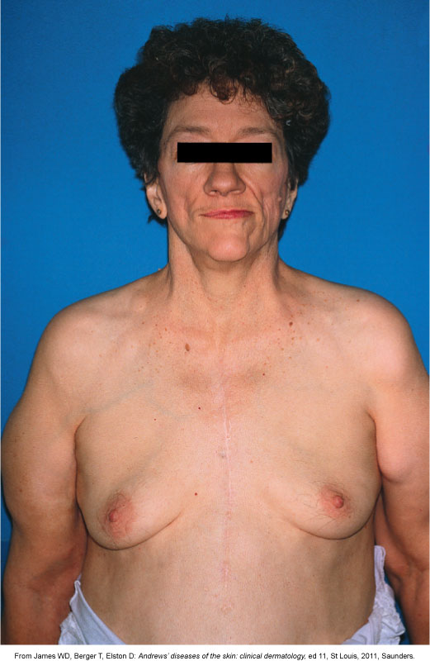
Lipodystrophy
Notes:
Other characteristics include changes in body shape
Fat deposits in abdomen, upper back, and breasts
Fat loss in arms, legs and face
May be due to lipodystrophy which manifests in:
A buffalo hump (hypertrophy)
Facial wasting.
Management of these metabolic disorders focuses on early detection, symptom management, and helping patients cope with emerging problems and changing treatment regimens, especially to avoid potentially fatal complications.
A frequent first intervention is to change ART medications because some drugs are more often associated with these disorders.

Slide 67
Case Study
iStockphoto/Thinkstock
One year later A.O. returns to the clinic with c/o night sweats and a productive cough for 1 week.
His CD4+ lymphocyte count is 76 cells/µL.
Notes:
He has an opportunistic infection and is likely HIV+.
Indications are it is:
Mycobacterium tuberculosis.
Collectively, the night sweats, productive cough, weight loss, and history of positive tuberculin skin test result indicate this diagnosis.

Slide 68
Case Study
He has lost 13 pounds in the last month.
His record shows a history of a positive PPD.
What do you think is happening?
iStockphoto/Thinkstock
Notes:
He has an opportunistic infection and is likely HIV+.
Indications are it is:
Mycobacterium tuberculosis.
Collectively, the night sweats, productive cough, weight loss, and history of positive tuberculin skin test result indicate this diagnosis.

Slide 69
End-of-Life Care
Focus of nursing intervention
Patient comfort
Promoting acceptance of finite nature of life
Helping significant others deal with loss
Maintaining safe environment
Notes:
Despite new developments in the treatment of HIV infection, many patients eventually experience disease progression, disability, and death.
Sometimes treatments do not work for the patient.
Sometimes the patient’s HIV becomes resistant to all available drug therapies.
In other cases, a patient may make a decision to forego further treatment, allowing the disease to progress toward death.
(End-of-life care is discussed in Chapter 11.)

Slide 70
Gerontologic Considerations
Increasing rates of HIV disease among older adults
Death rate from opportunistic infections reduced
People 60 and older are increasingly being infected.
Notes:
The number of persons over age 60 living with HIV is anticipated to grow.
As a nurse, you need to be aware of the special health concerns of the HIV-infected older adult.
They are susceptible to the same diseases (heart, cancer, diabetes, bone disease, arthritis, HTN, kidney disease, cognitive impairment) as non-HIV-infected older people but
may experience them at an earlier age
may be at higher risk of co-morbidities due to the effects of the medications used to treat HIV.
Polypharmacy is a concern because the multiple medications older adults may have to take could have interactions or be potentiated by HIV medications.
It may be difficult for the older adult to get appropriate health care and support if they are ashamed and hesitate to tell anyone they have HIV.

Slide 71
Audience Response Question
A diagnosis of AIDS can be made for a patient with HIV with
a CD4+ T-cell count <500/µL.
a WBC count <3000/µL (3 × 10⁹/L).
development of oral candidiasis (thrush).
onset of Pneumocystis jiroveci pneumonia.
Notes:
Answer: d
Rationale: The Centers for Disease Control (CDC) has established criteria for a patient to be diagnosed with AIDS. AIDS is diagnosed when an HIV-positive individual develops at least one of several criteria: examples are CD4⁺ T-cell count less than 200 cells/uL and fungal infection such as Pneumocystis jiroveci pneumonia (PCP). Candidiasis infection must be of the bronchi, trachea, lungs, or esophagus (not only the mouth).

Slide 72
Audience Response Question
The nurse working in an HIV testing and treatment clinic plans teaching about antiretroviral therapy for a
patient who tested positive for HIV 3 years ago and has developed tuberculosis.
male health care worker who is HIV negative but has unprotected sex with men.
patient who was infected with HIV 10 years ago and has a CD4+ T-cell count of 650/μL.
patient with persistent generalized lymphadenopathy who was exposed to HIV 2 years previously.
Notes:
Answer: a
Rationale: Antiretroviral therapy initiation is recommended for the following patients infected with HIV: history of AIDS-defining illness (such as tuberculosis), CD4⁺ T-cell count <200 cells/uL or between 200 and 350 cells/uL, pregnant women, persons with HIV-associated nephropathy, and persons co-infected with hepatitis B.

Slide 73
Audience Response Question
The nurse is caring for a patient who is receiving antiretroviral therapy (ART) for treatment of AIDS. Which assessment best indicates that the patient’s condition is improving?
Decreased viral load
Increased drug resistance
Decreased CD4⁺ T-cell count
Increased aminotransferase levels
Notes:
Answer: a
Rationale: Goals of antiretroviral therapy (ART) in the treatment of a patient with HIV are to decrease the viral load and maintain or increase CD4+ T-cell counts. Combination drugs are prescribed to prevent or decrease drug resistance. Some of these drugs may impair liver function; increased aminotransferase levels indicate impaired liver function.

Slide 74
Audience Response Question
The nurse informs the patient with a bacterial pneumonia that the most important factor in antibiotic treatment is
antibiotics should have been used to prevent pneumonia.
all of the supplied antibiotics should be taken even when symptoms have resolved.
enough antibiotics for 2 days’ treatment should be reserved in case symptoms recur.
patients should request antibiotics for upper respiratory infections to prevent development of streptococcal-related diseases.
Notes:
Answer: b
Rationale: To prevent the emergence of antibiotic-resistant organisms, patients need to take the entire prescription even if symptoms have resolved. Antibiotics should not be used routinely to prevent bacterial pneumonia.

